Slide 1
Teams & Power Platform
Notes:
This document is provided “as-is”. Information and views expressed in this document, including URL and other Internet Web site references, may change without notice. You bear the risk of using it.
This document does not provide you with any legal rights to any intellectual property in any Microsoft product. You may copy and use this document for your internal, reference purposes.
© 2019 Microsoft. All rights reserved.
INSTRUCTIONS:
Set Screen Resolution to 1920x1080
Start the Slide Show
If you are projecting to a second monitor, use Presenter View on your PC to read the talk track and see where to click next (note that this is a PowerPoint, so the “clicks” are intended to make the presentation as close to a Live Code demo as possible)
CLICK STEP
Click anywhere to continue.

Slide 2
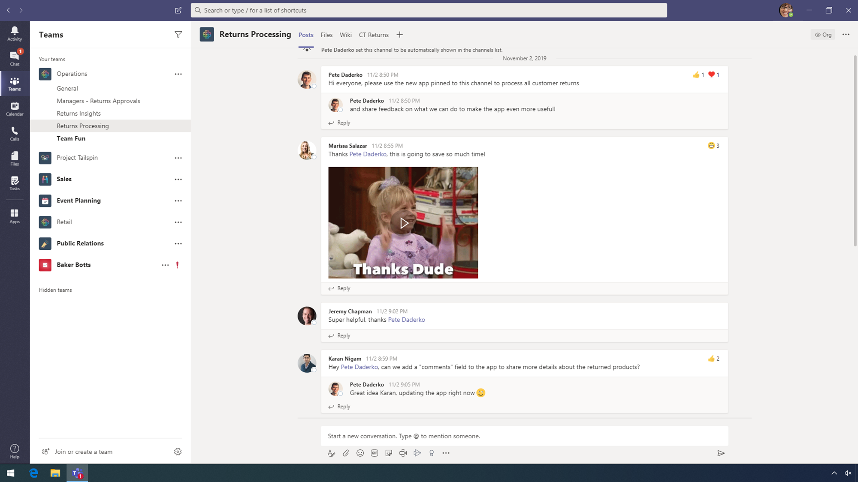
Title Template 1
Notes:
Microsoft Teams has built in features, enabling employees to customize their own workspaces. Over the past two years, this customized experience has grown dramatically. Organizations can now build their own applications and integrate them seamlessly into their teams within Microsoft Teams platform.
Megan Bowen is a customer service representative at Contoso Electronics and is responsible for processing returns. Contoso has created their own returns app using the Microsoft Power Platform to improve their returns workflow for their representatives, while leveraging PowerApps, Power Automate, and Power BI.
To improve efficiencies in inspecting and processing returns, Megan uses a low code, mobile-friendly app, built with Microsoft PowerApps, to keep pace with customer’s demands.
CLICK STEP
At the top, click CT Returns app.

Slide 3

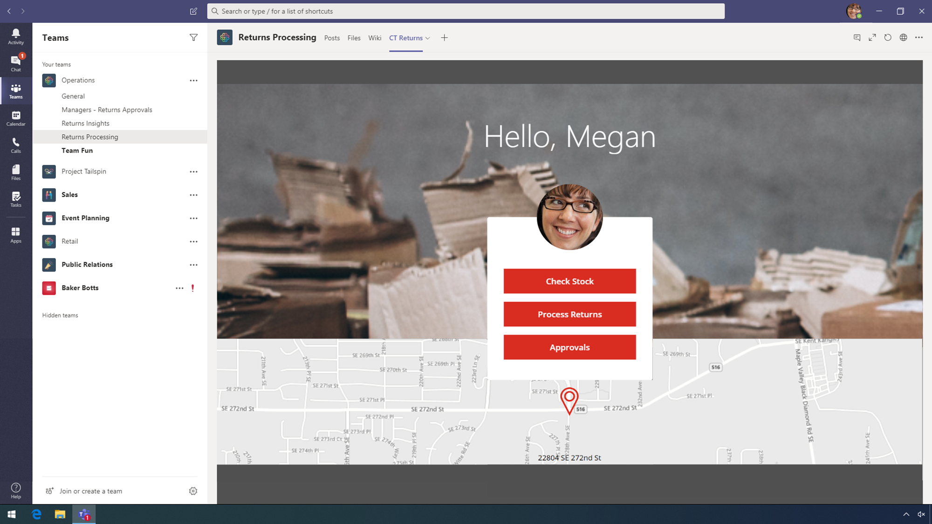
Title Template 2
Notes:
From the home screen, Megan can Check Stock, Process Returns, and review Approvals. Megan needs to process the return of a drone because it has a broken light, so she clicks Process Returns.
CLICK STEP
Click Process Returns.

Slide 4
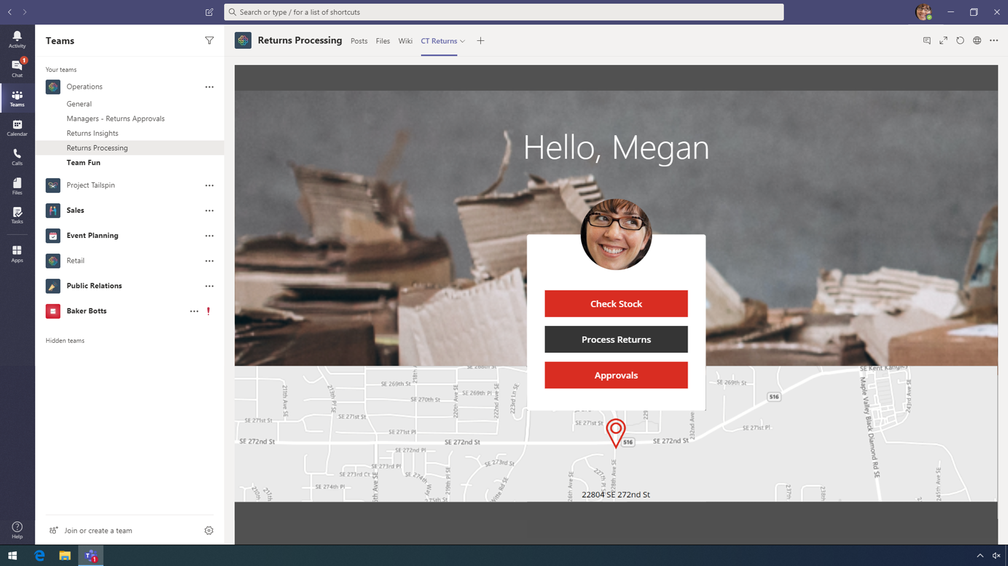
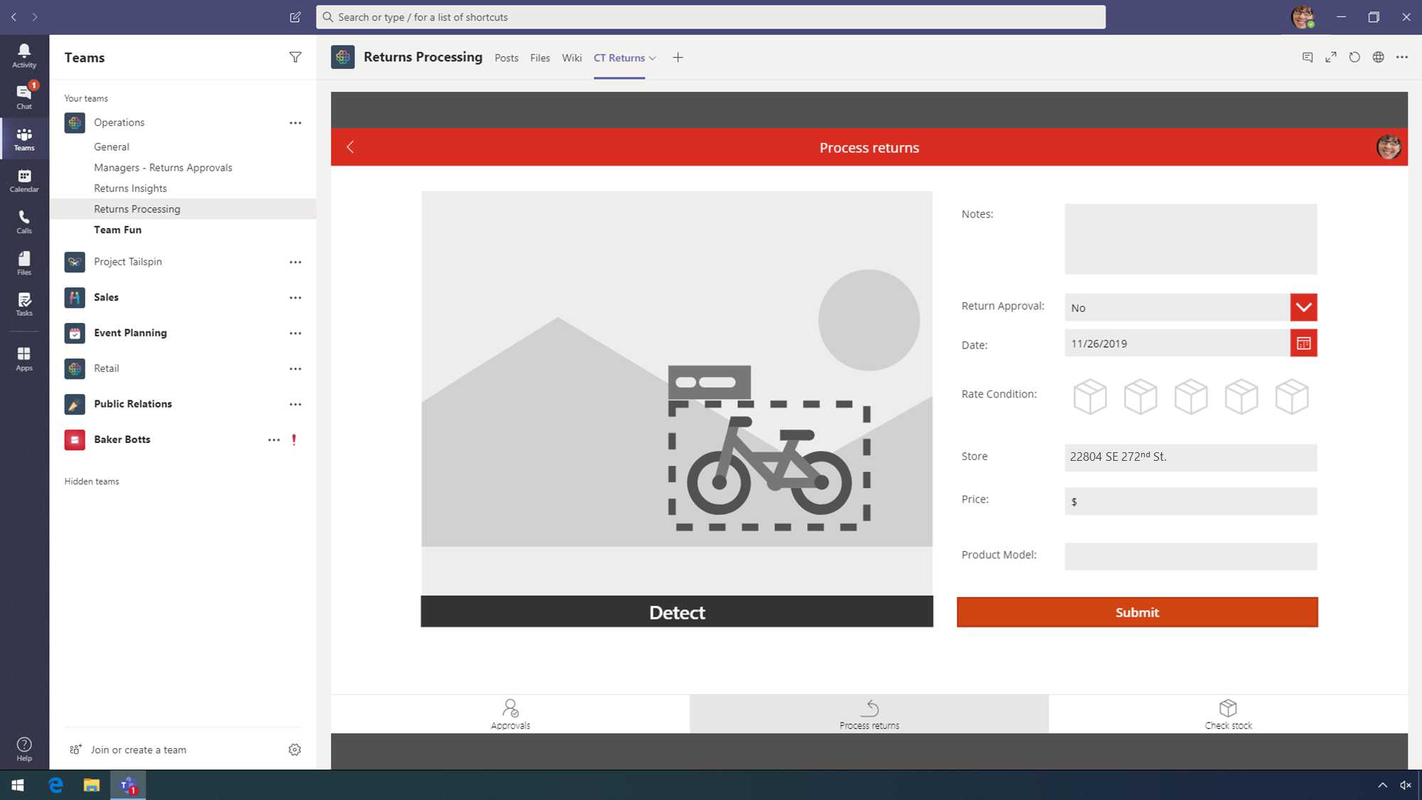
Title Template 3
Notes:
On the audit screen, Megan simply needs to upload a picture of the returned product to begin processing the return.
CLICK STEP
Click Detect.

Slide 5
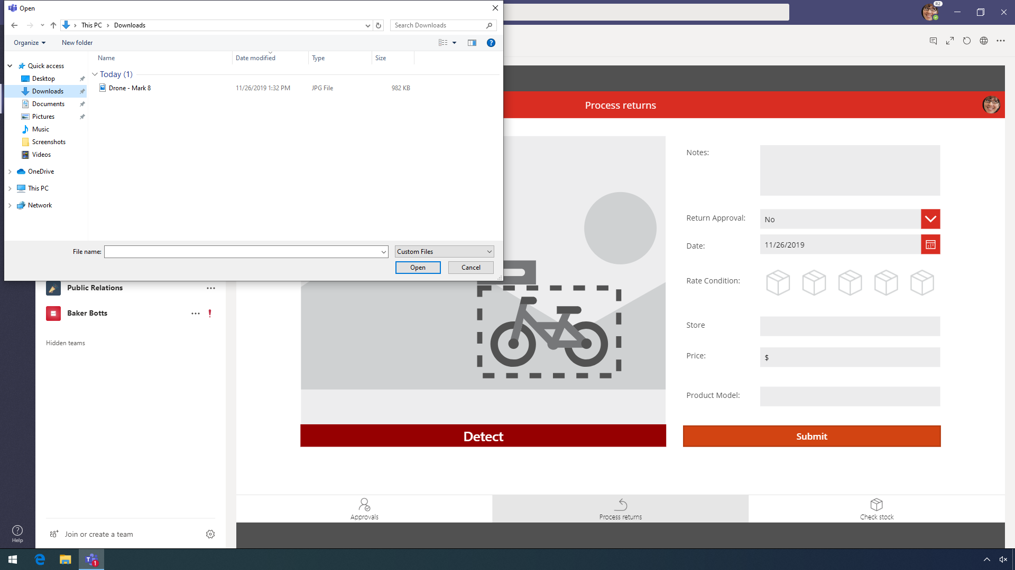
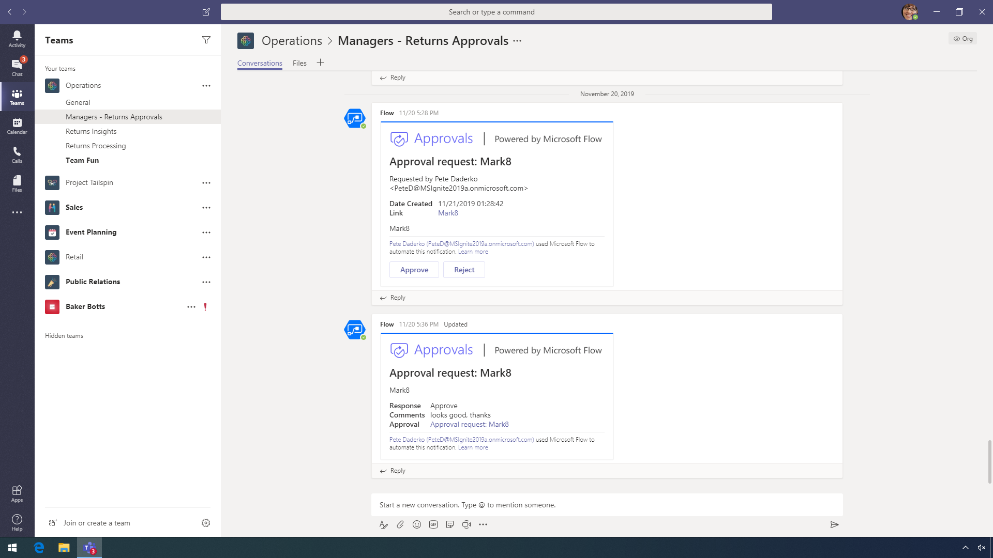
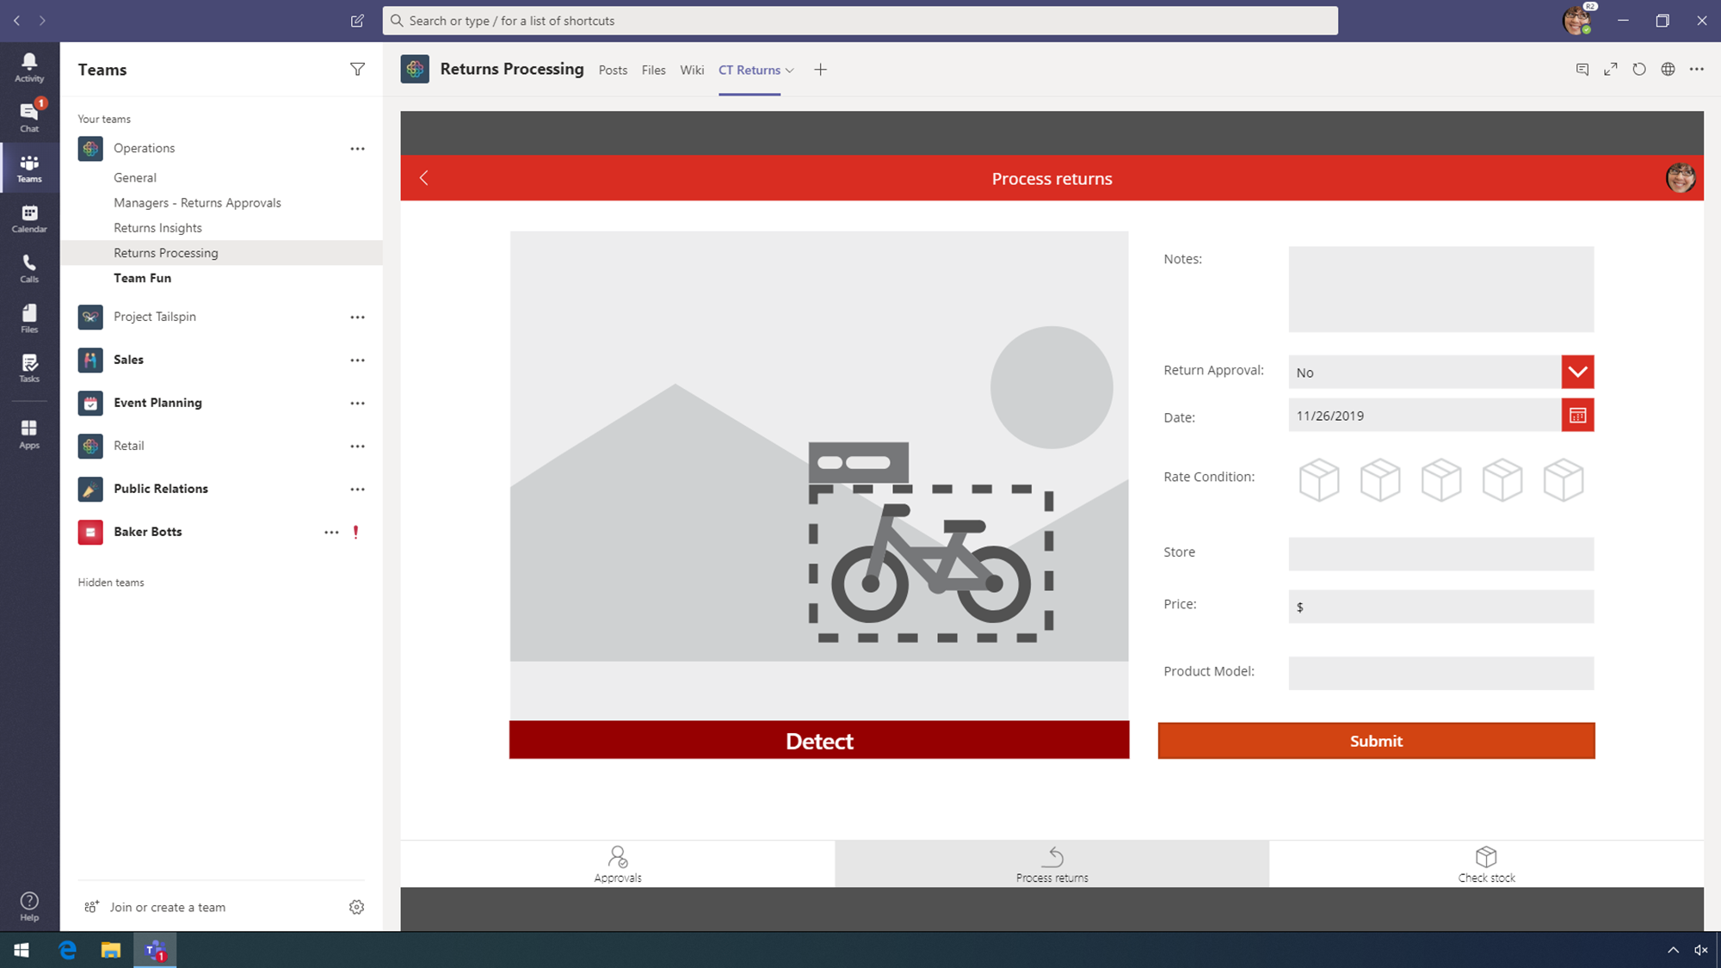
Title Template 4
22804 SE 272nd St.
Notes:
CLICK STEP
Click Drone – Mark 8.

Slide 6
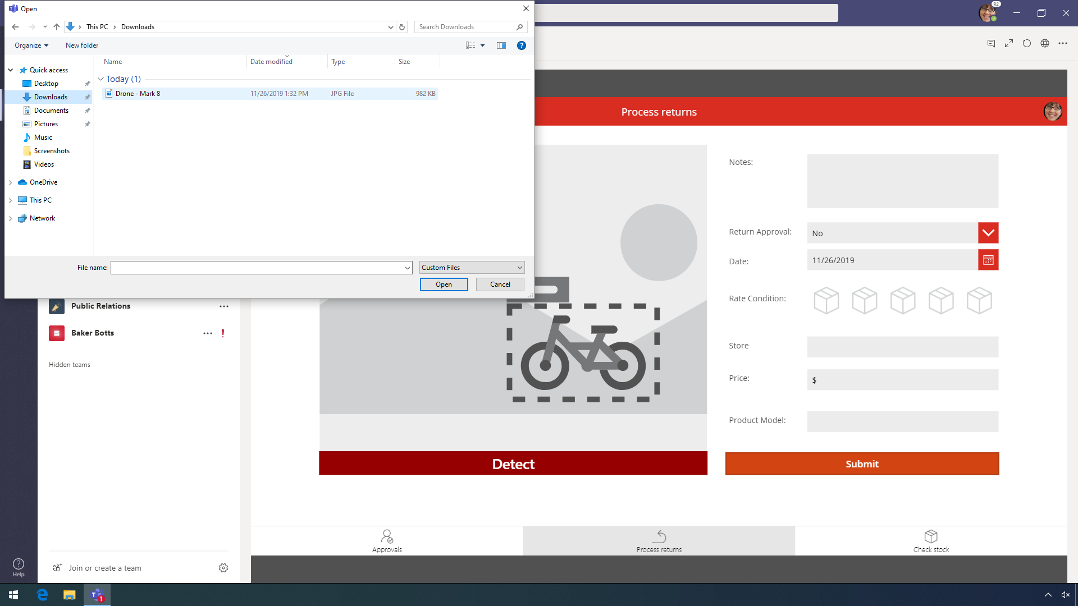

22804 SE 272nd St.
Notes:
CLICK STEP
Click Open.

Slide 7

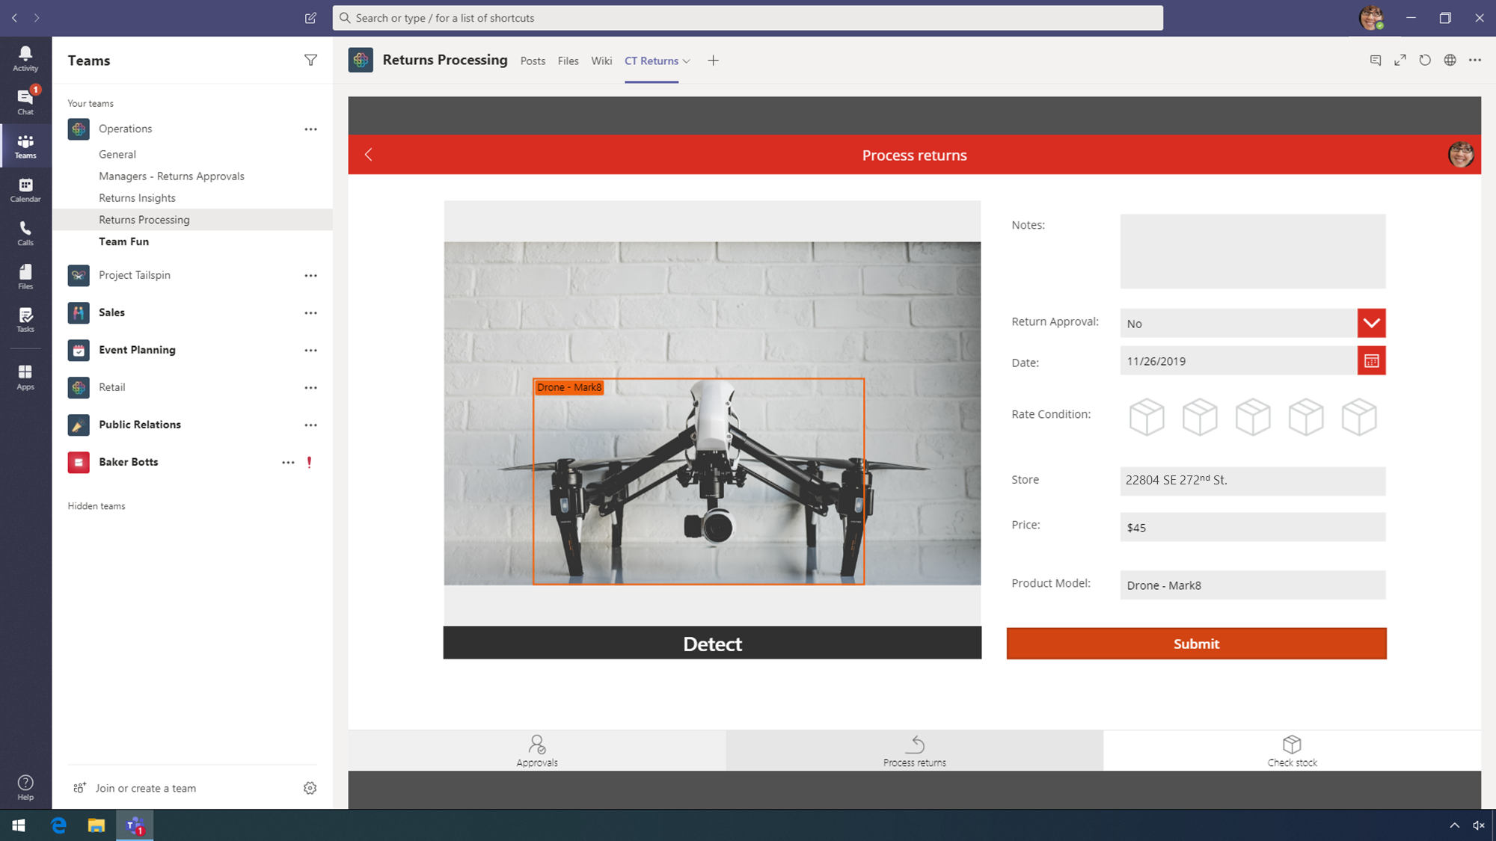
Title Template 5
Notes:
With AI Builder, she can leverage AI machine learning by taking this picture and letting the app determine what the product is.
POINT OUT:
On the right, above Submit, point to, but do not click, Product Model: Drone – Mark8.
AI machine learning also gives Megan the price.
POINT OUT:
Above, Product Model, point to, but do not click, Price.
This is a huge time saver!
CLICK STEP
Click Notes to trigger typing animation.

Slide 8
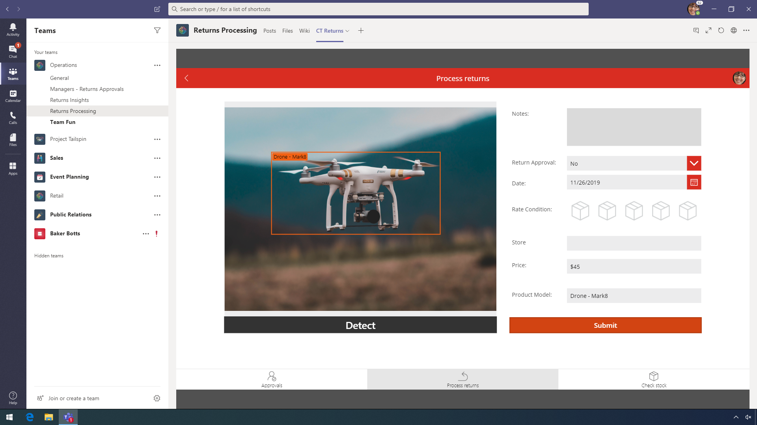








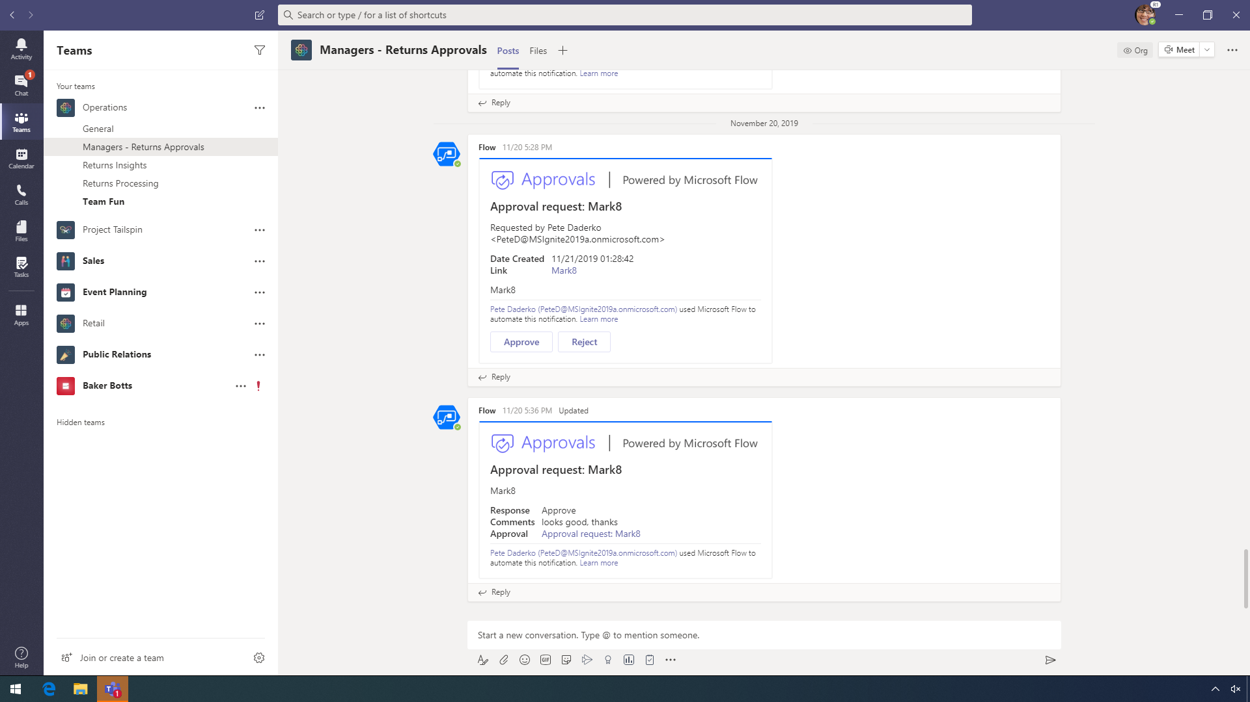

Title Template 6
22804 SE 272nd St.
Notes:
[PowerPoint will auto-type Broken light.]
CLICK STEP
Click the Return Approval drop-down.

Slide 9
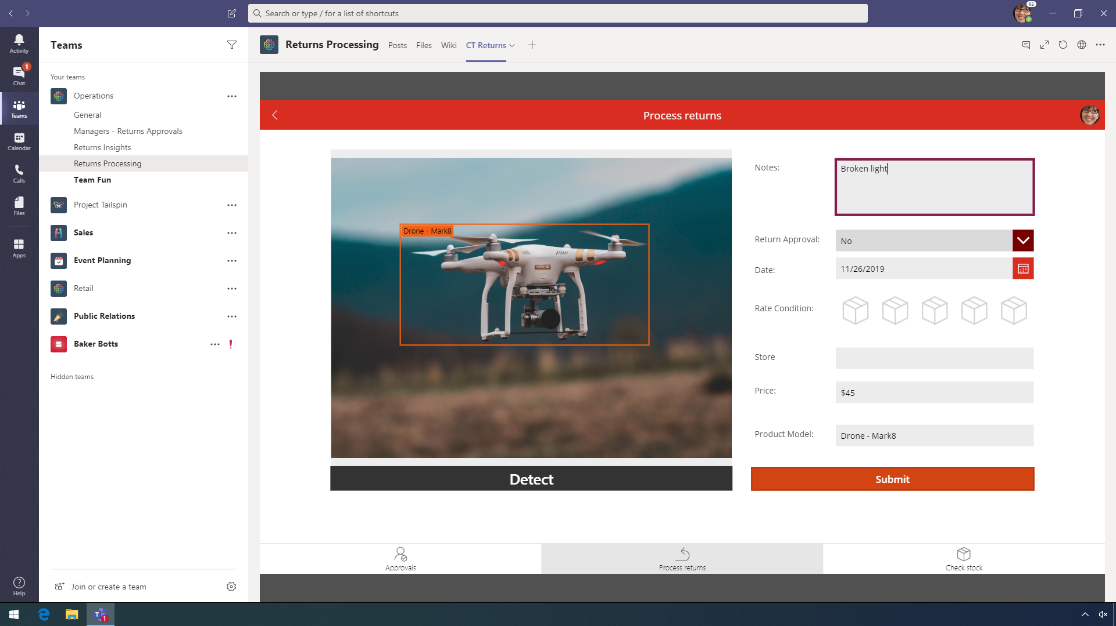
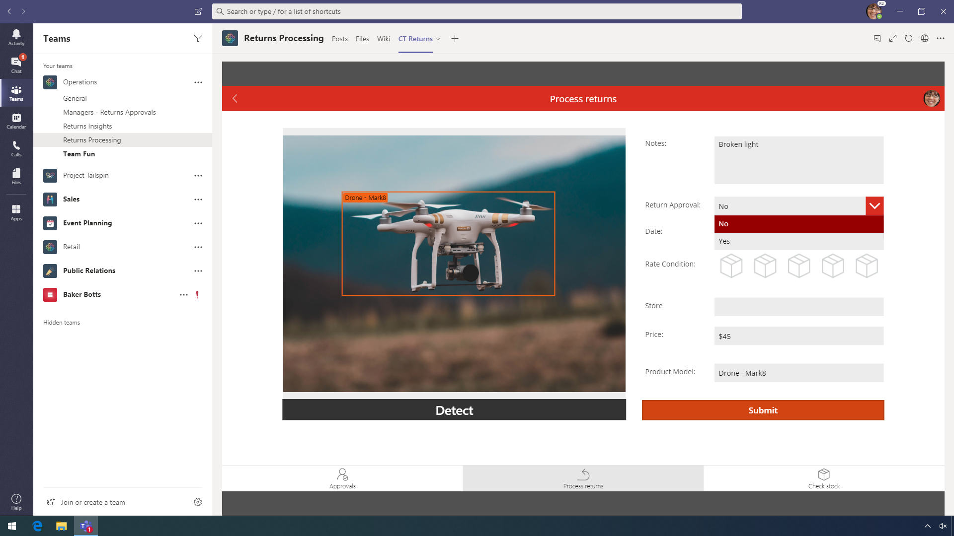
22804 SE 272nd St.
Notes:
CLICK STEP
Click Yes.

Slide 10

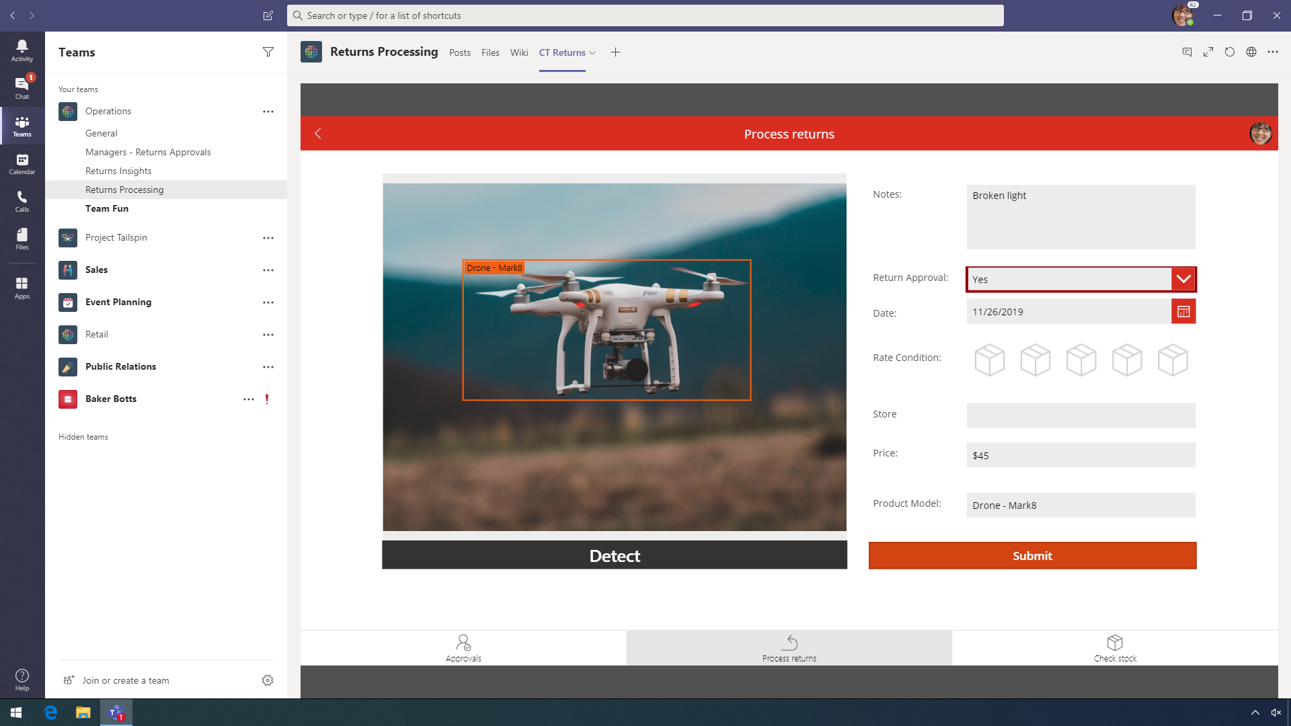
22804 SE 272nd St.
Notes:
CLICK STEP
In Rate Condition, click the 4th box.

Slide 11

Notes:
From here, Megan submits the audit and finishes her inspection of the returned drone.
CLICK STEP
Click Submit.

Slide 12
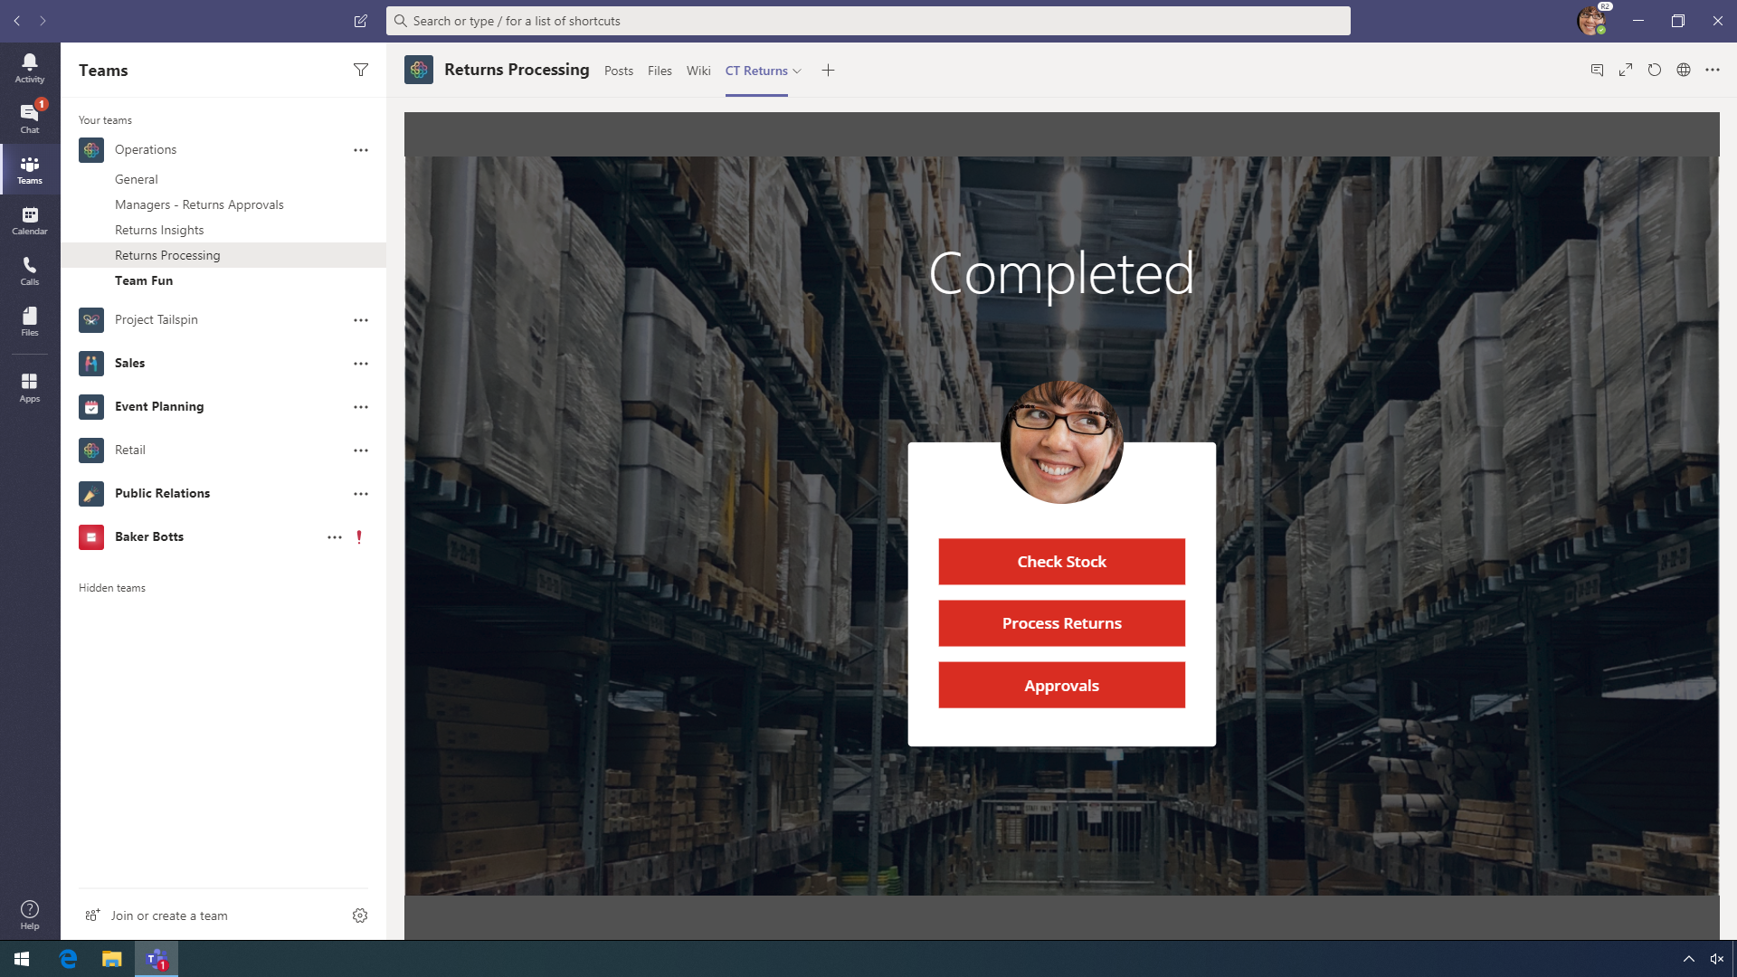

Notes:
Megan can now use the time saved for even more returns and building relationships with customers through meaningful conversations.
Adding an app to a team channel is as simple as…
CLICK STEP
At the top, next to CT Returns, click + to add a new tab.

Slide 13

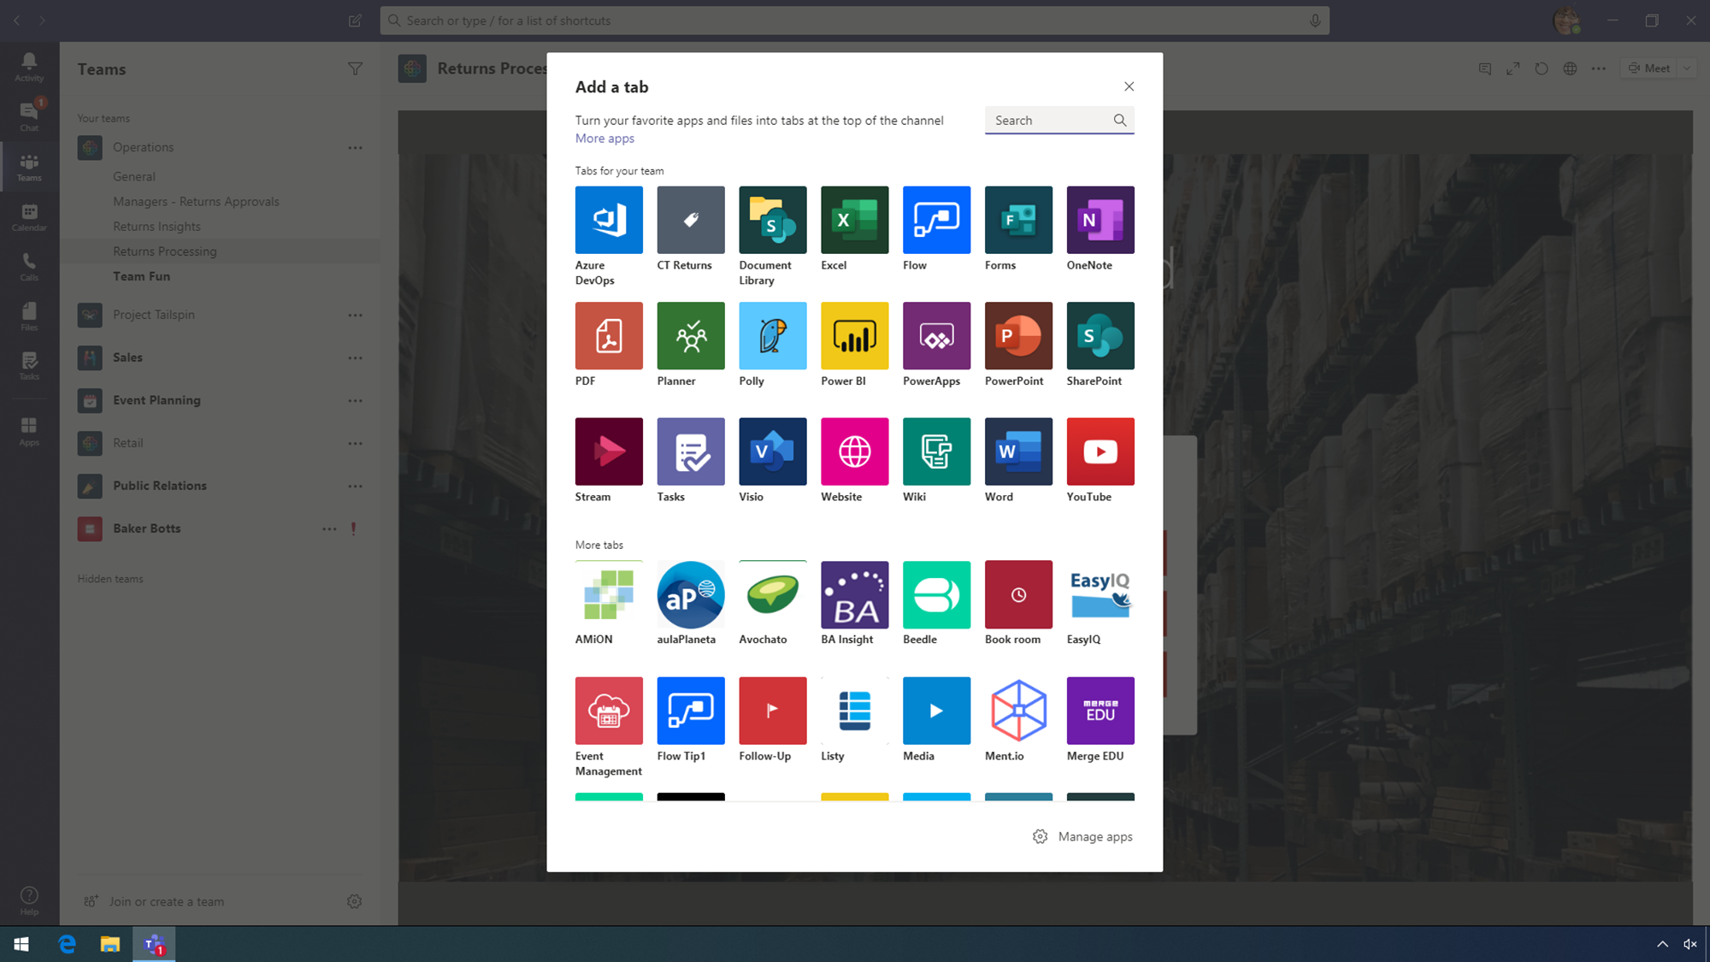
Notes:
…two clicks!
POINT OUT:
Point to, but do not click, CT Returns.
CLICK STEP
Click X to close the Add a tab pane.

Slide 14
Notes:
CLICK STEP
Click the Managers – Returns Approvals channel of the Operations team.

Slide 15
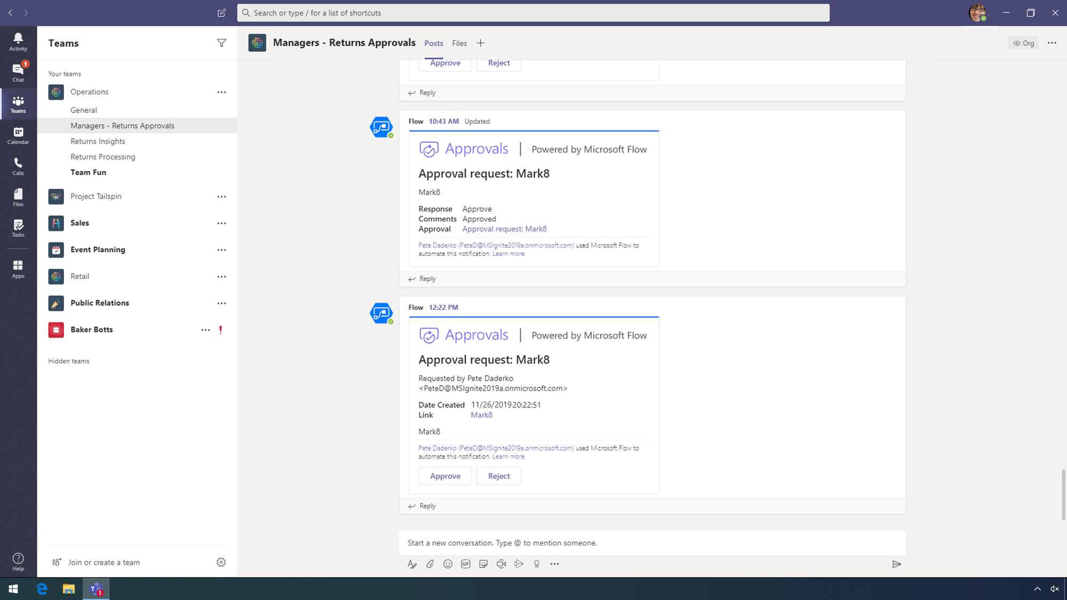
Notes:
It isn’t effective for Megan’s manager to manually track and approve each return manually, so Contoso has automated this process with Power Automate.
CLICK STEP
Click the scrollbar to trigger scrolling animation.

Slide 16
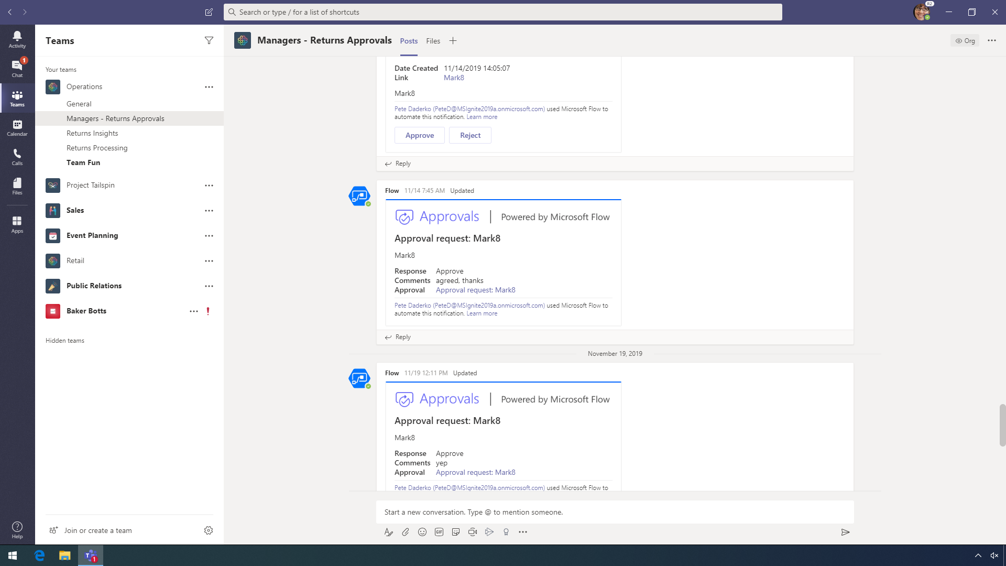
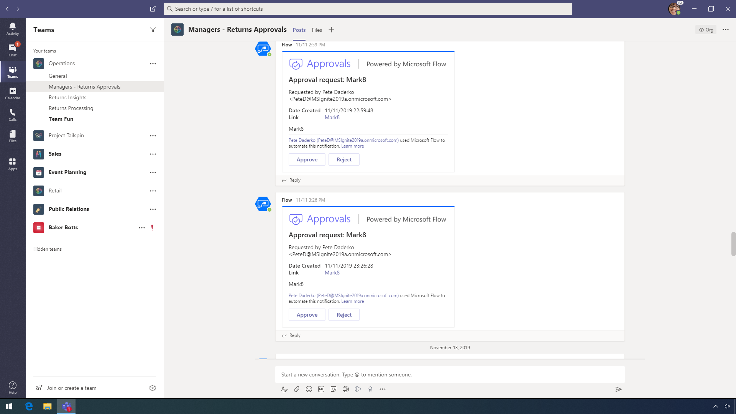
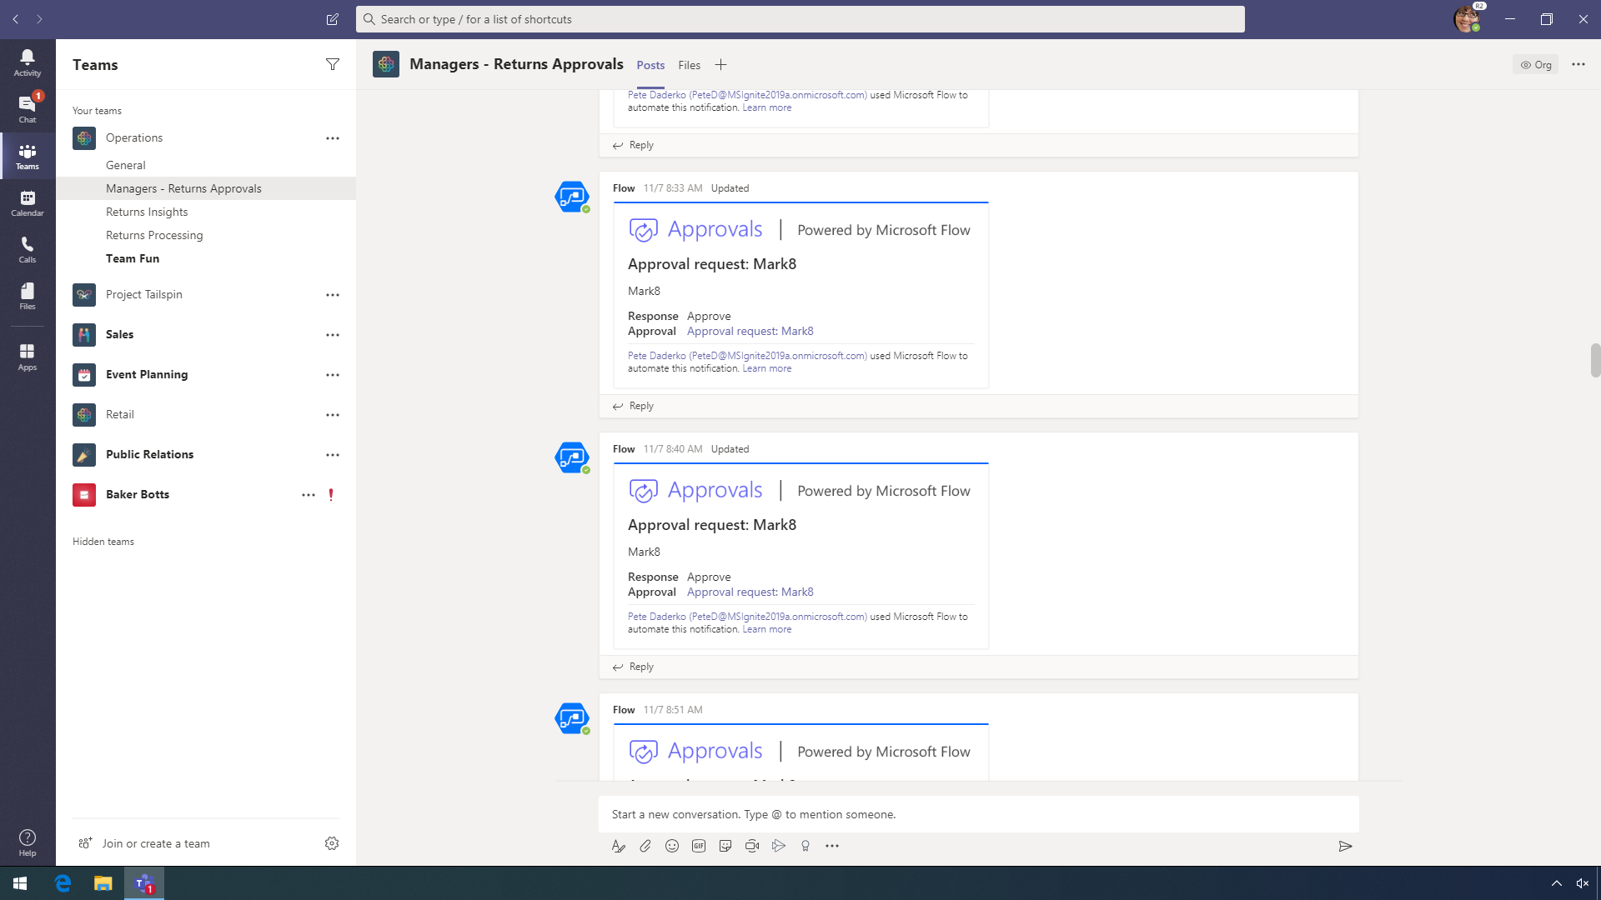
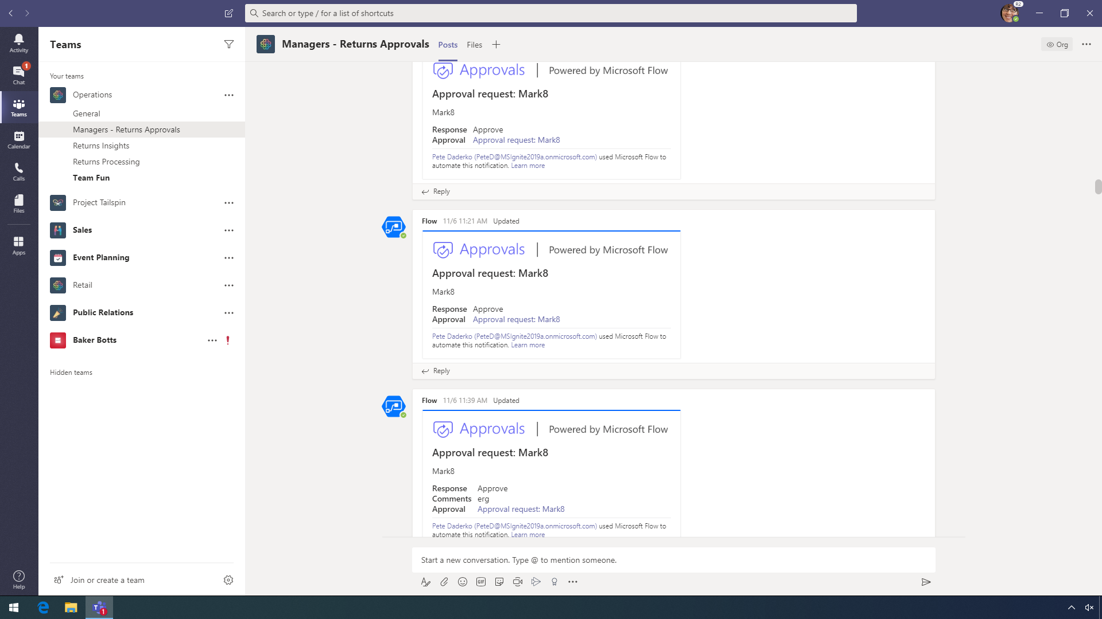
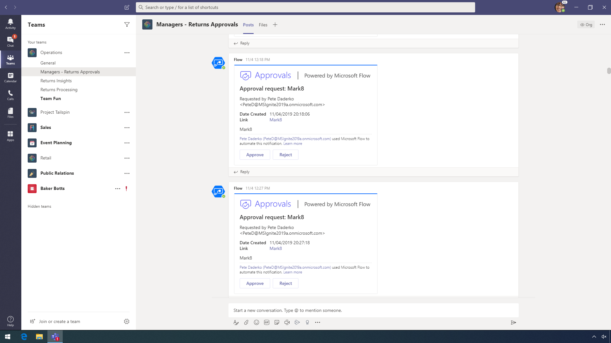
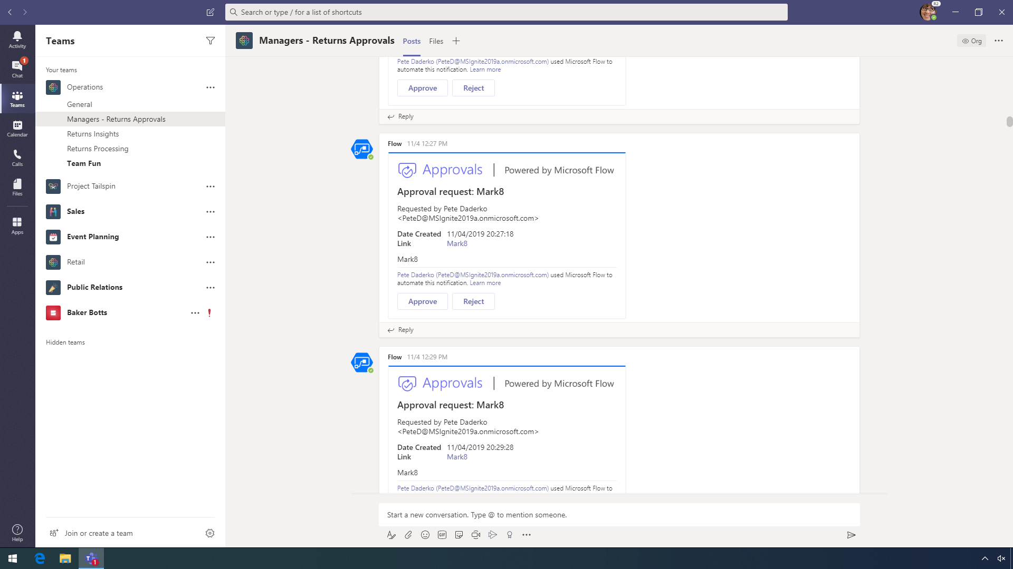
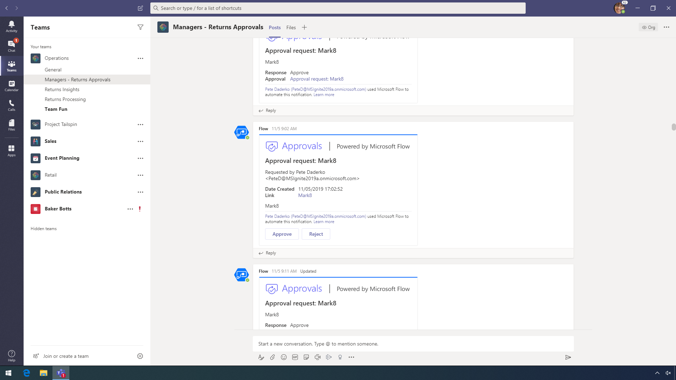
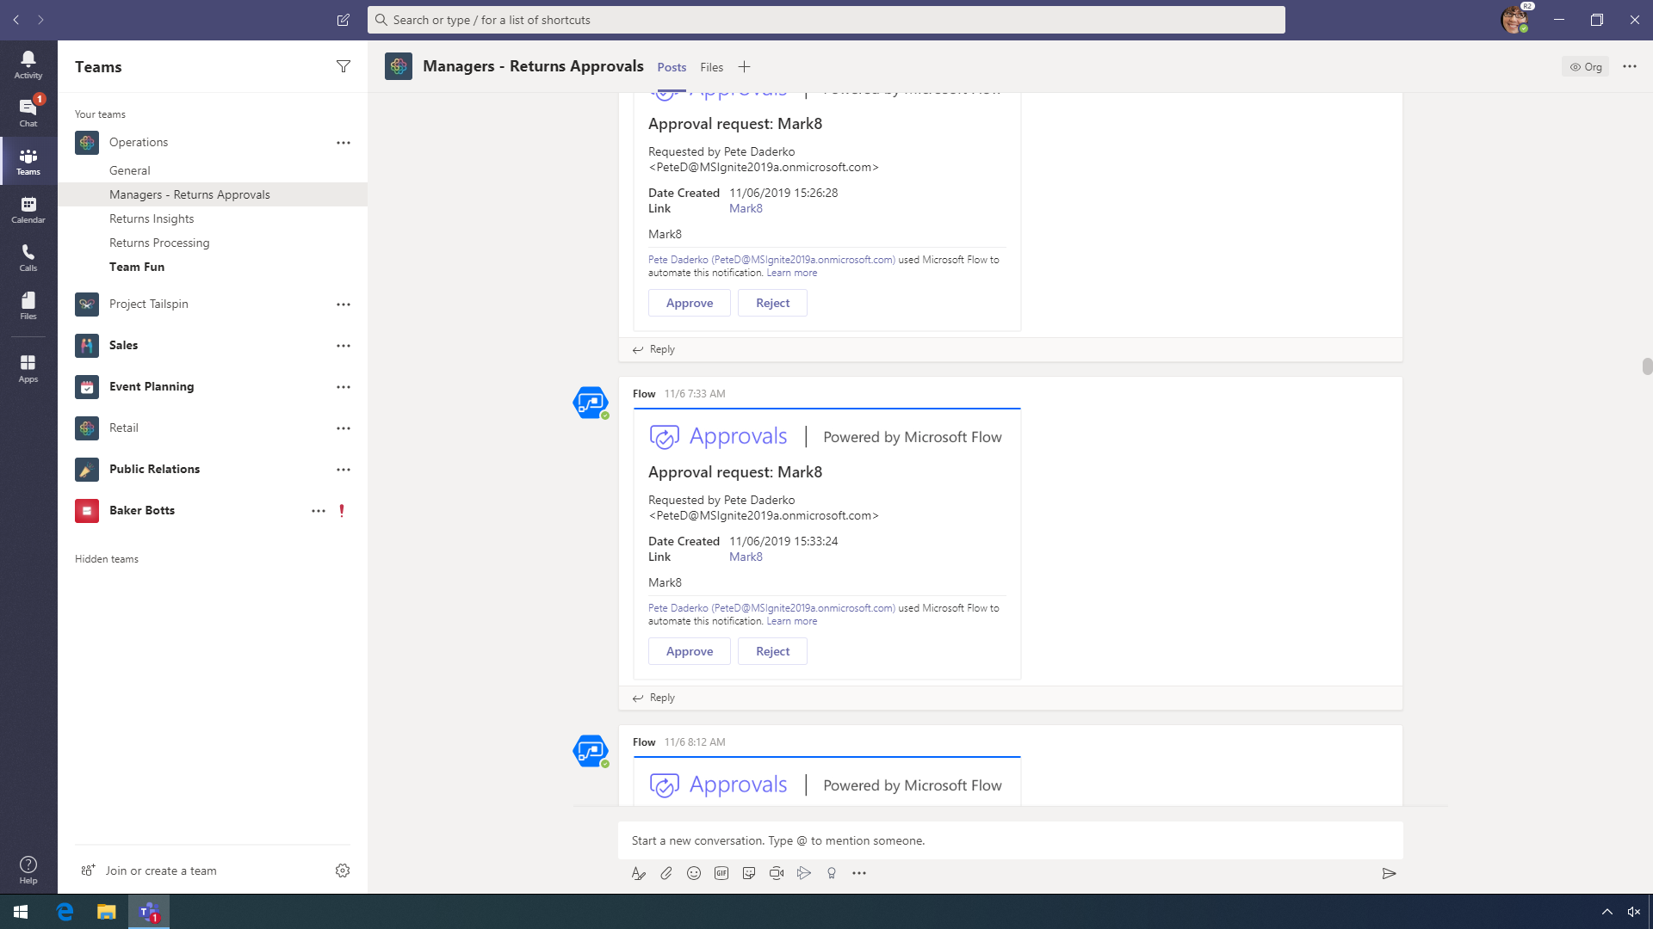
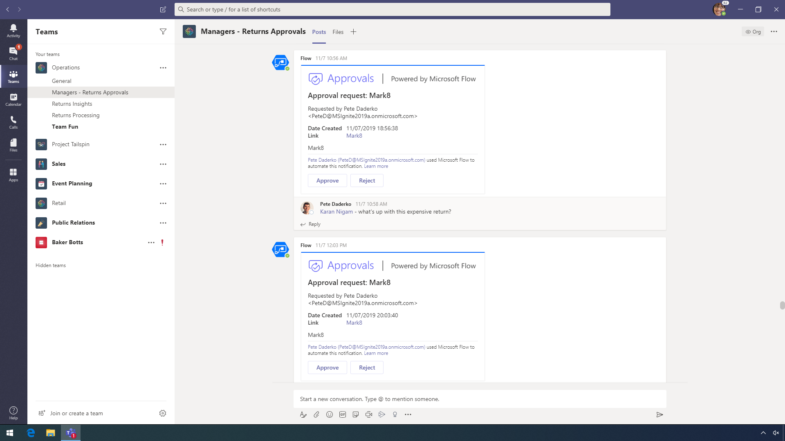

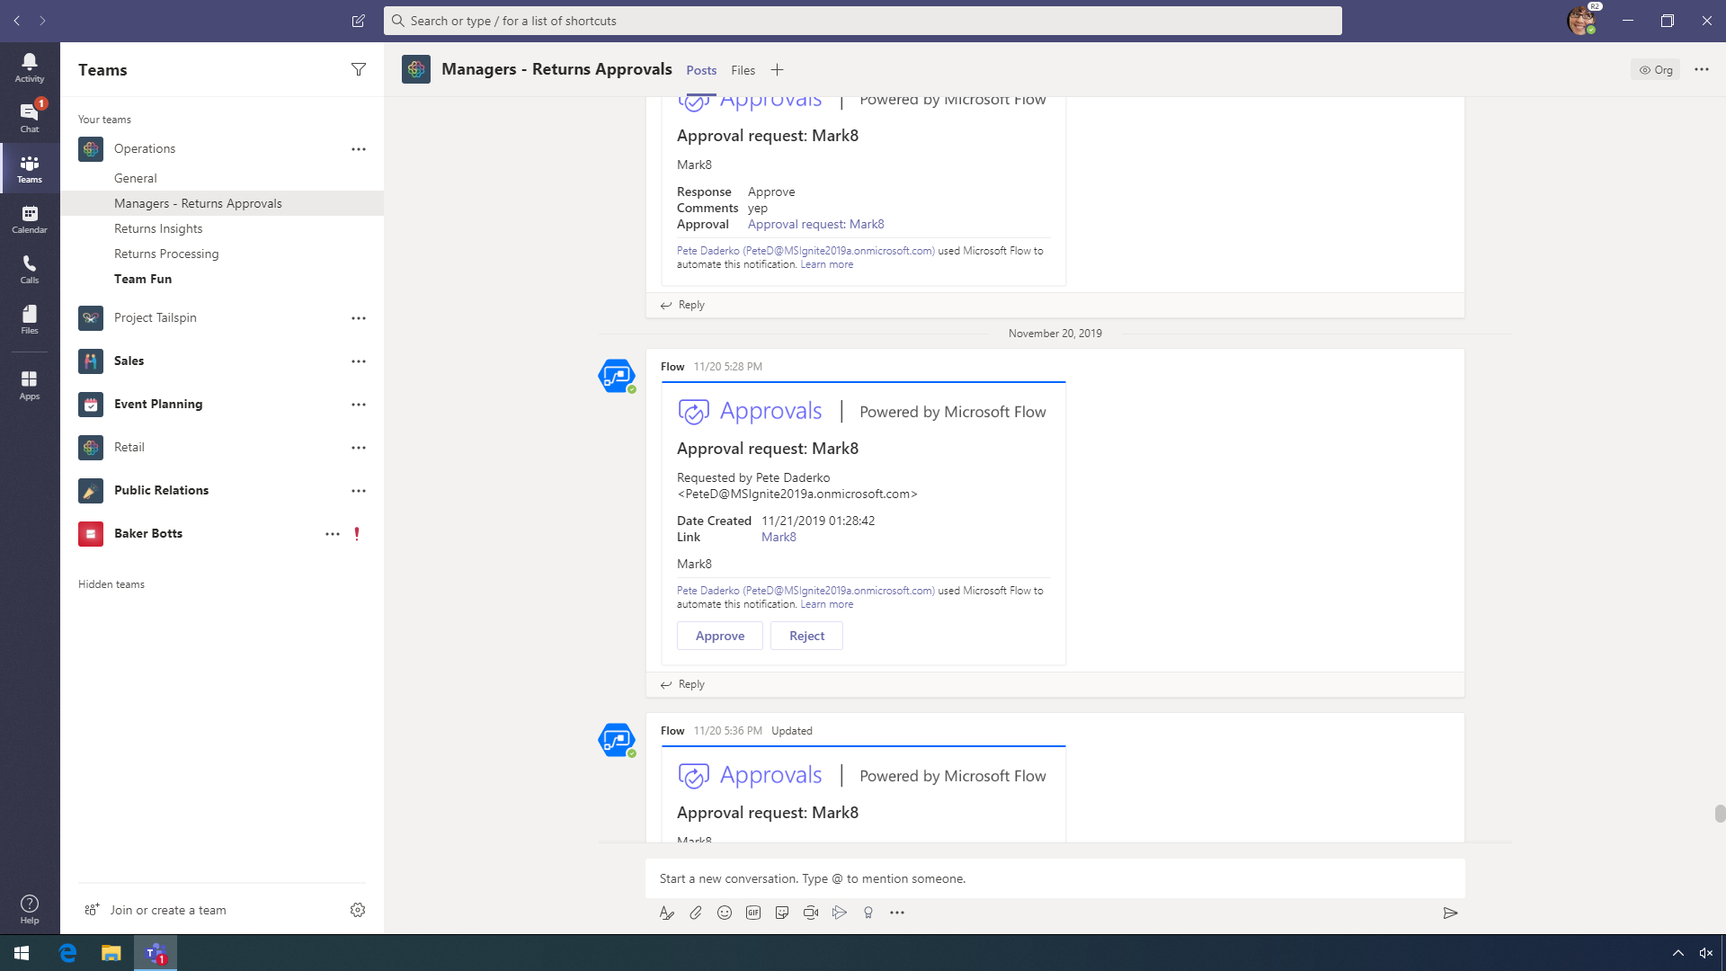
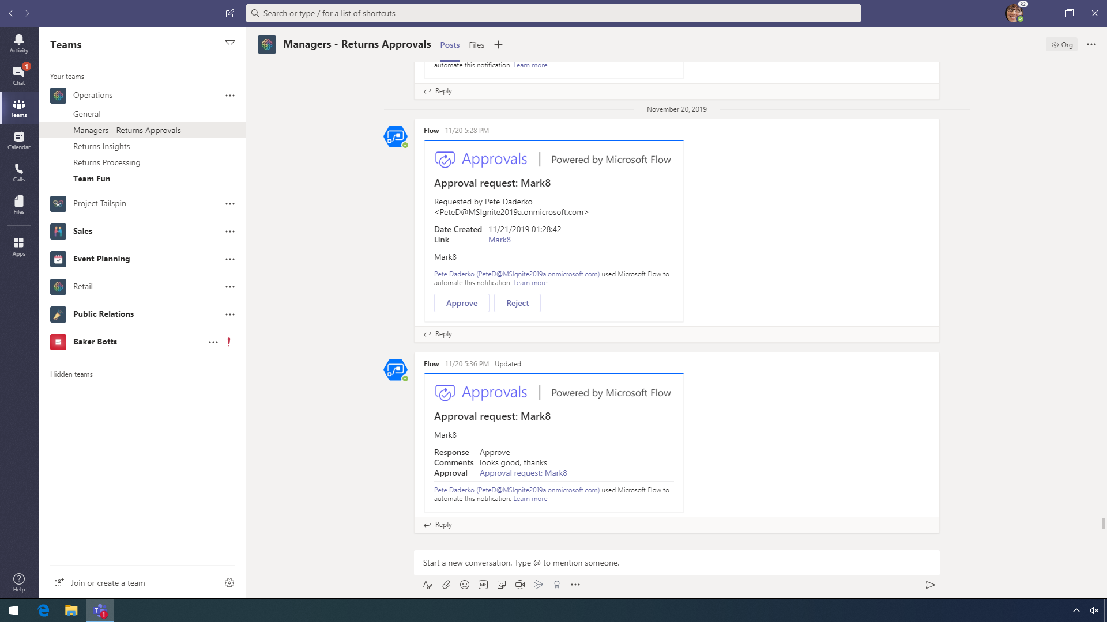
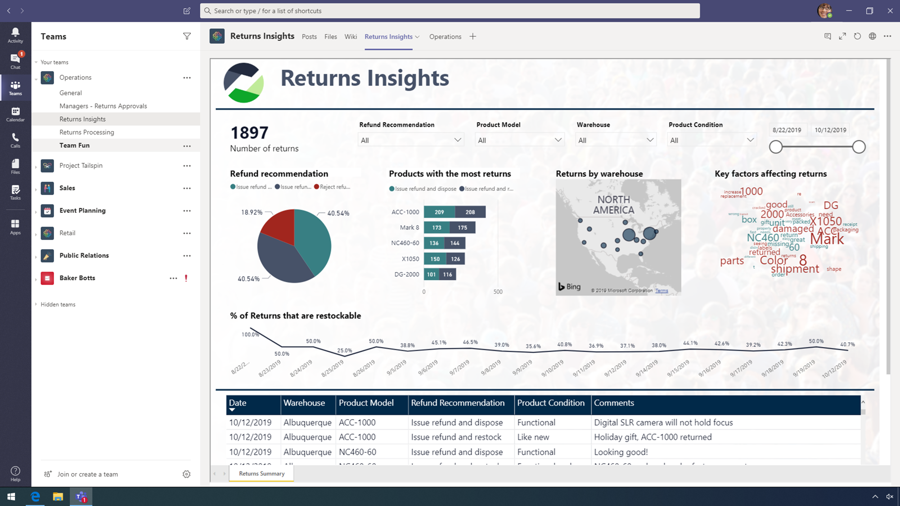

Notes:
[PowerPoint will auto-scroll through previous approvals.]
From the Managers – Return Approvals team, managers can review the details of each return and approve or reject the return. Managers have a running track of all the processed returns and can track approvals, ensuring that Contoso remains in compliance.
POINT OUT:
Point to, but do not click, the details of the last approval request.
CLICK STEP
Click Approve.

Slide 17
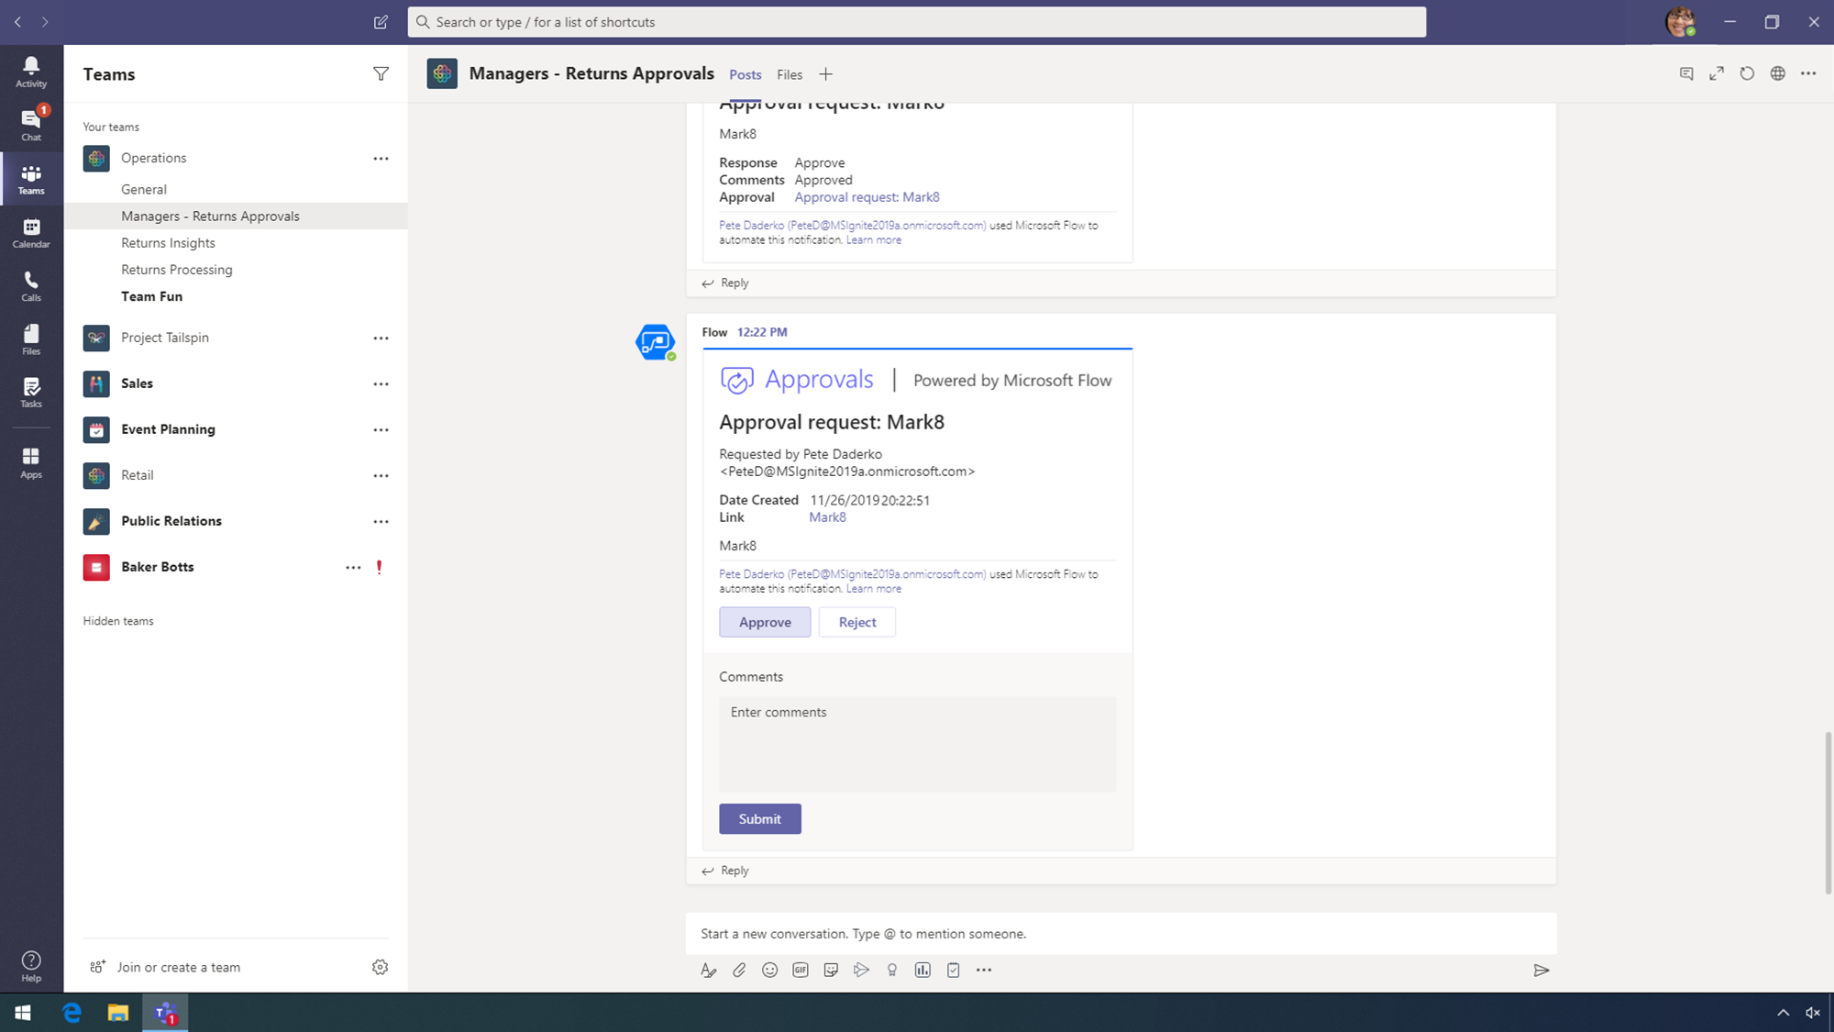
Notes:
CLICK STEP
Click Enter comments to trigger typing animation.

Slide 18
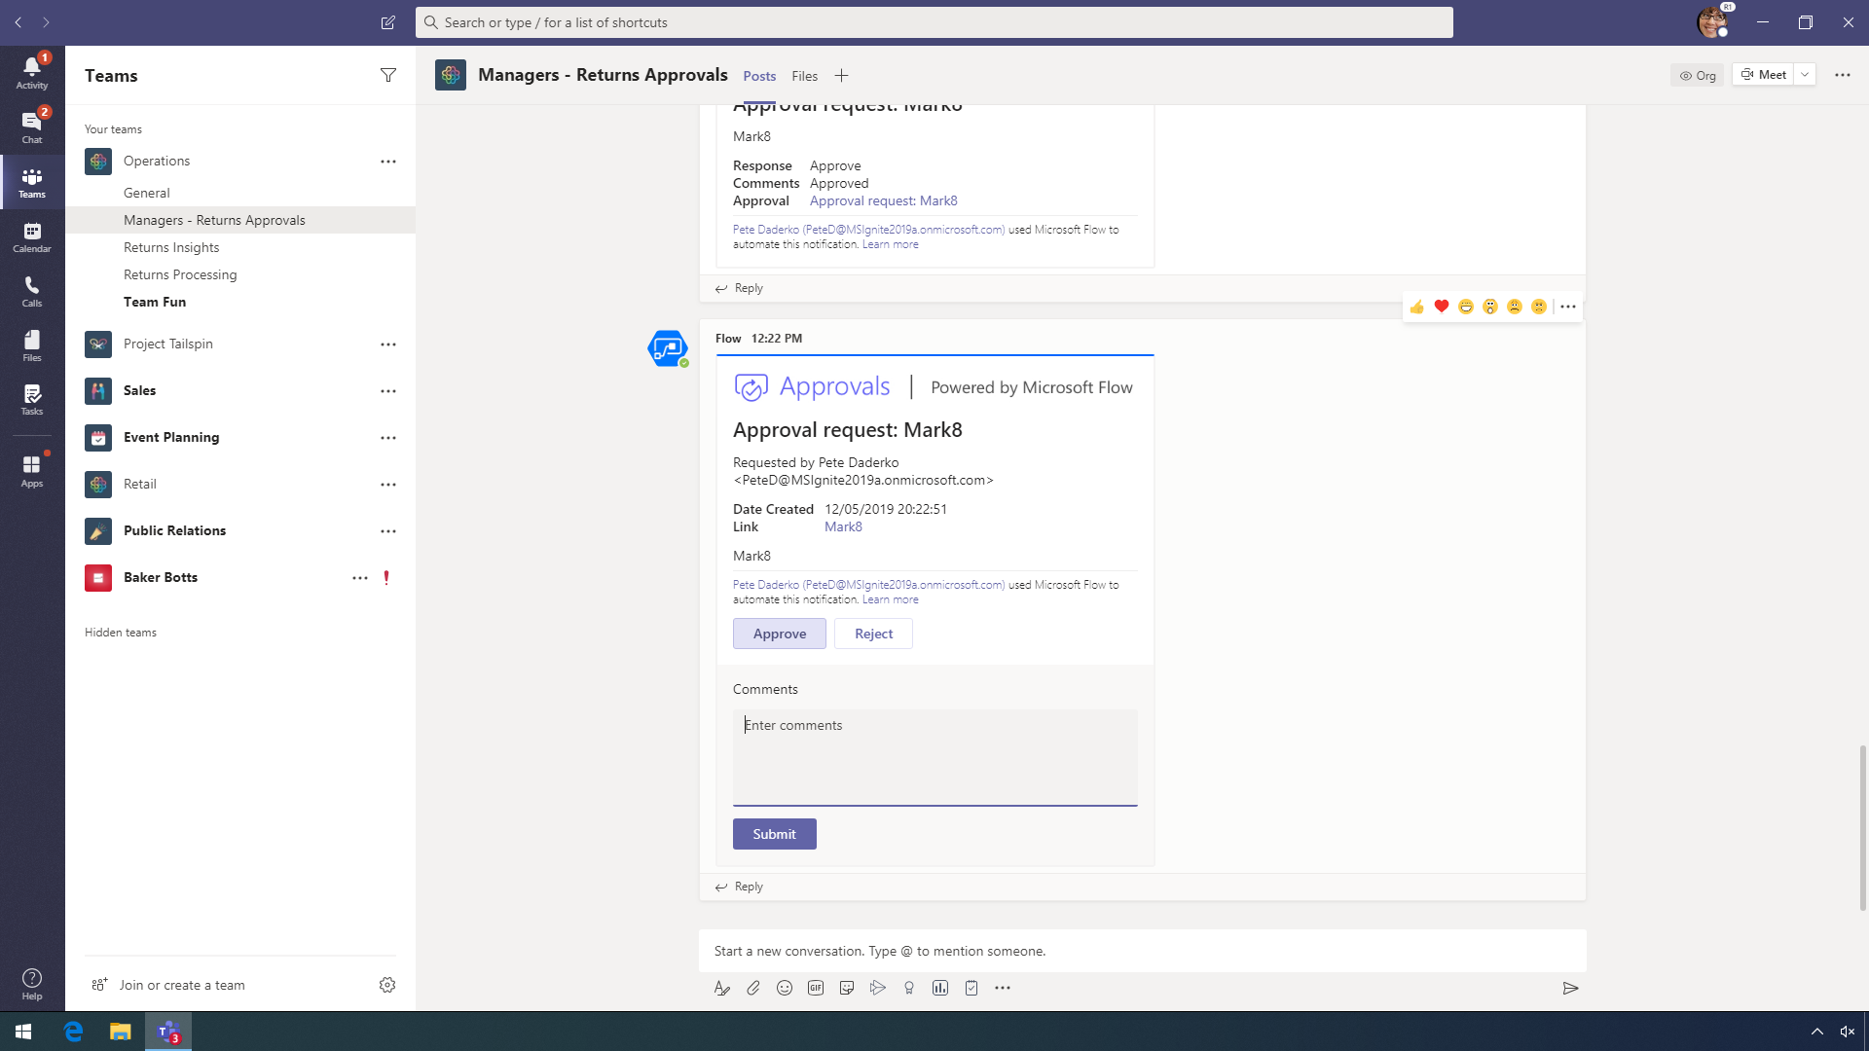
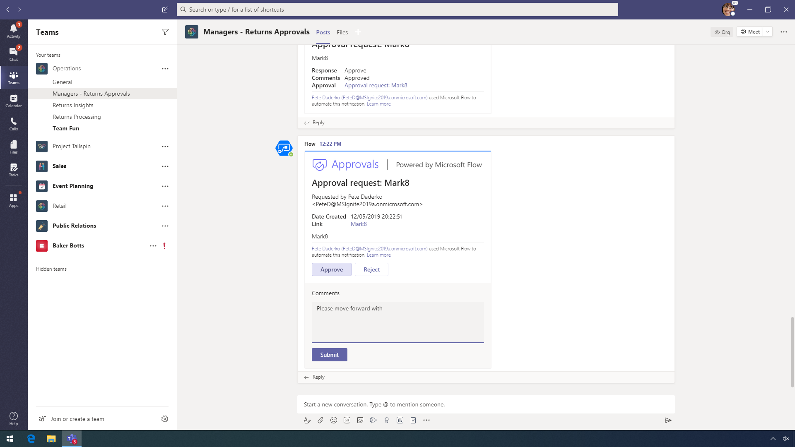





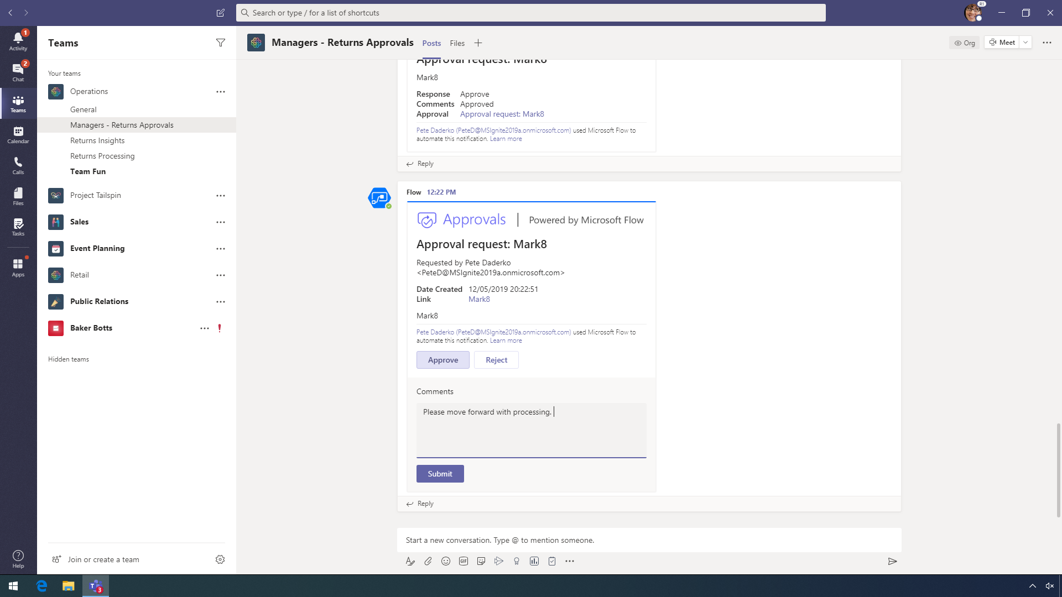
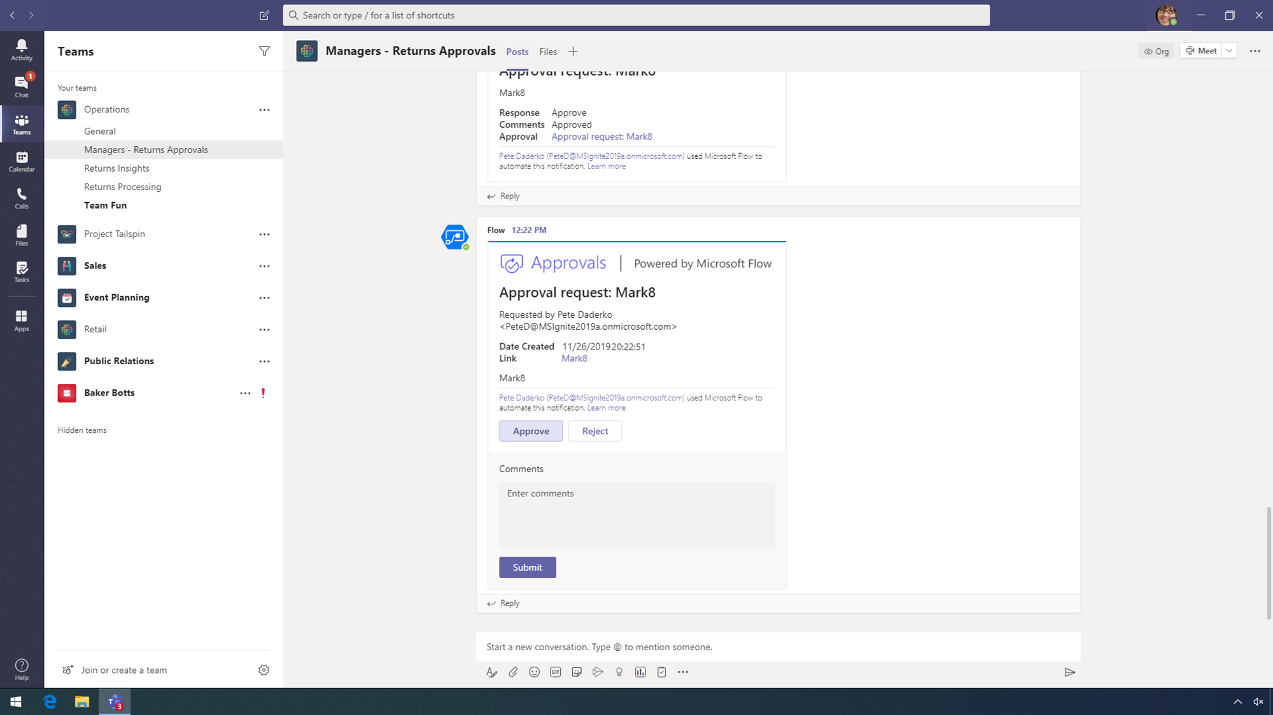
Notes:
CLICK STEP
Click Submit.

Slide 19
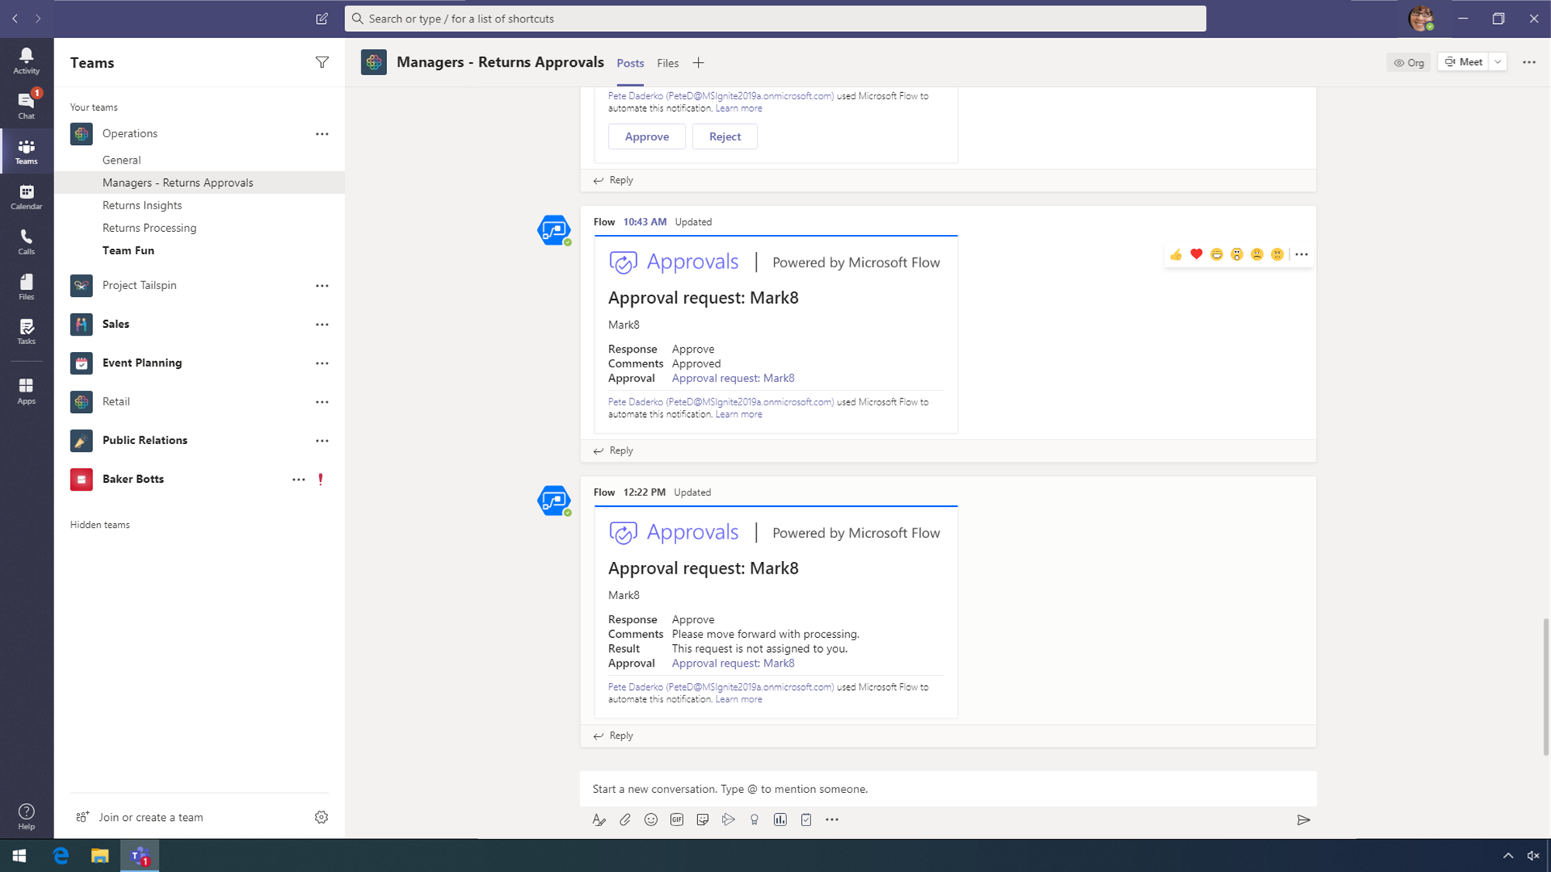
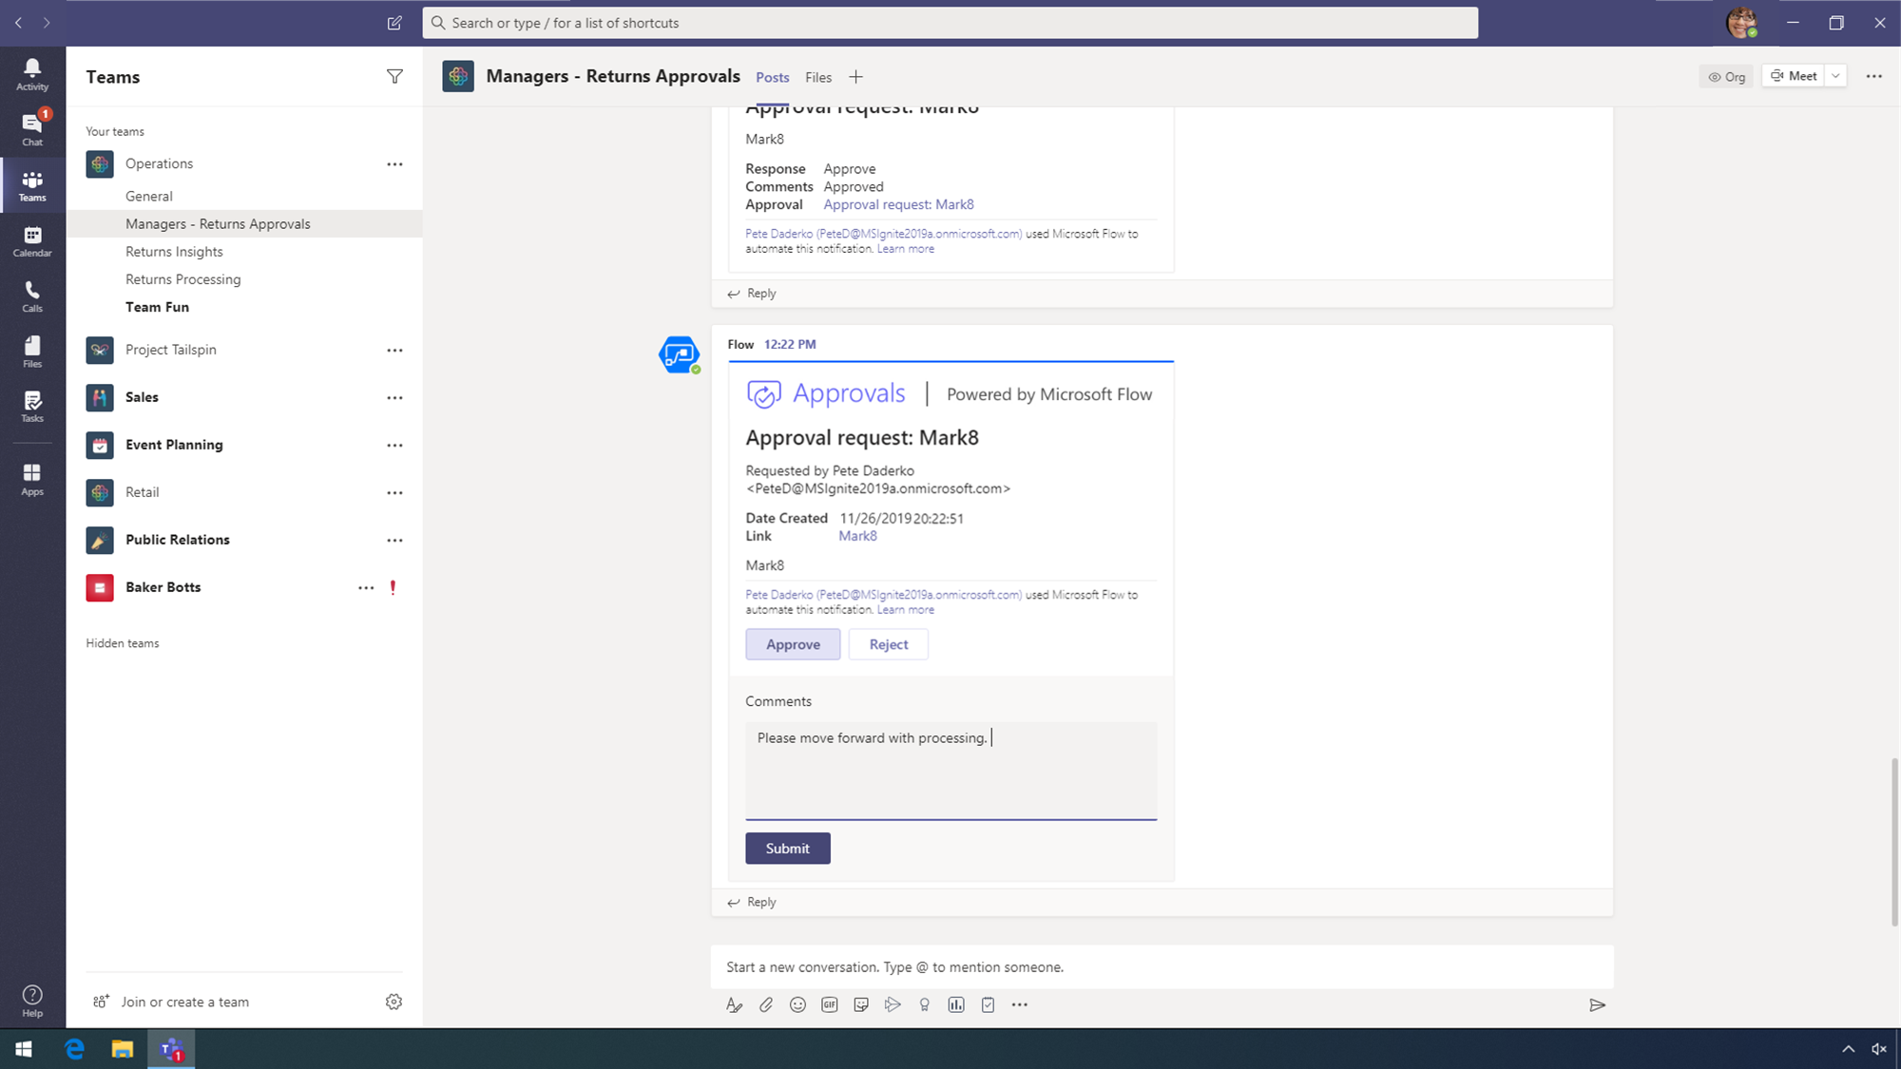
Notes:
CLICK STEP
Click the Returns Insights channel of the Operations team.

Slide 20
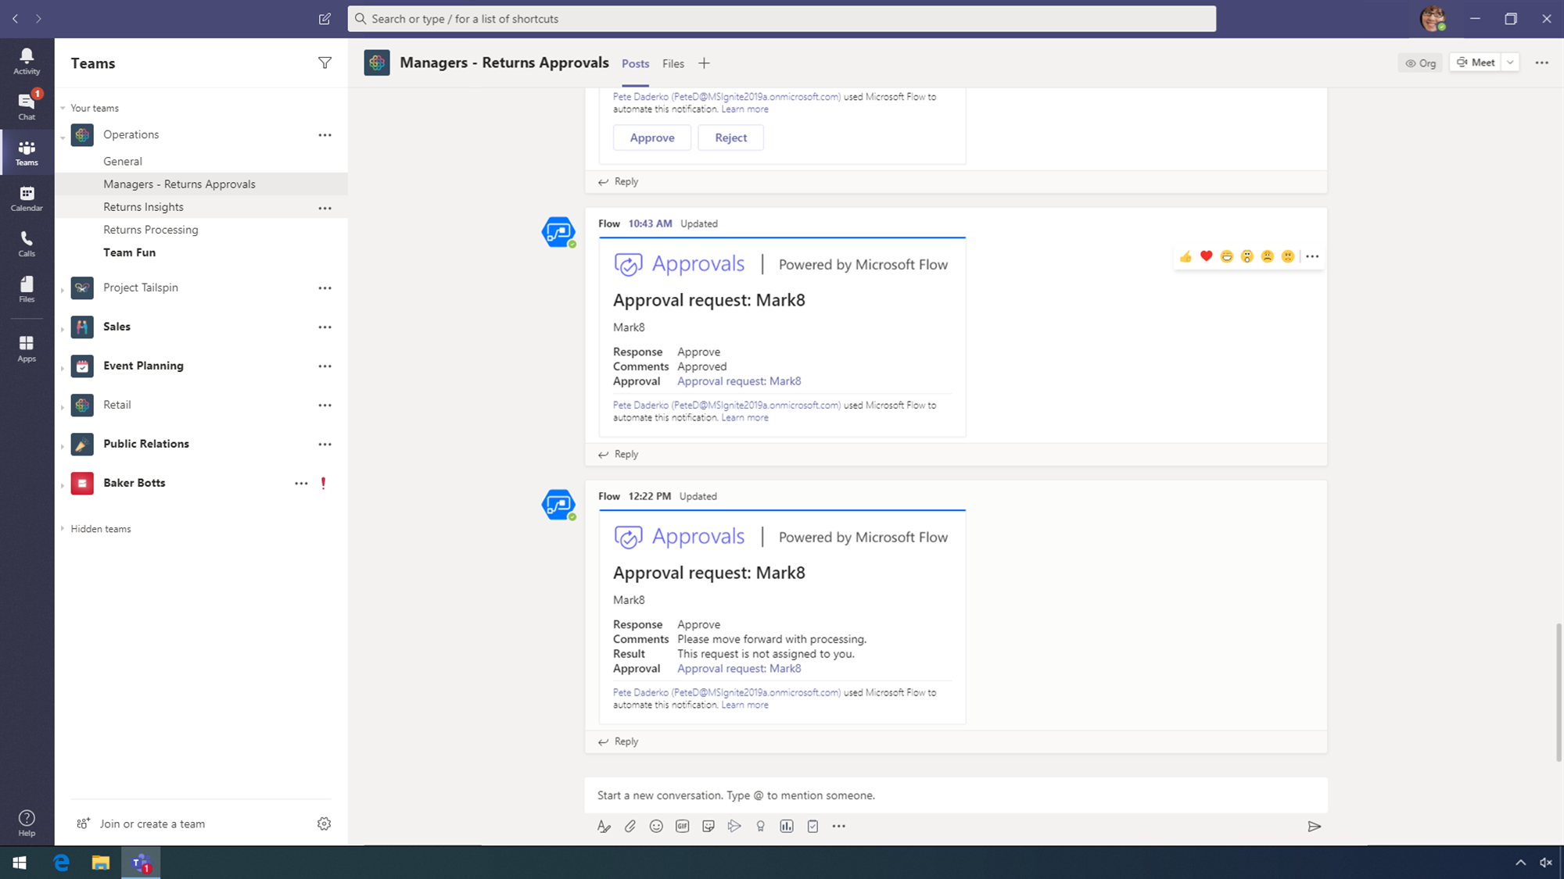
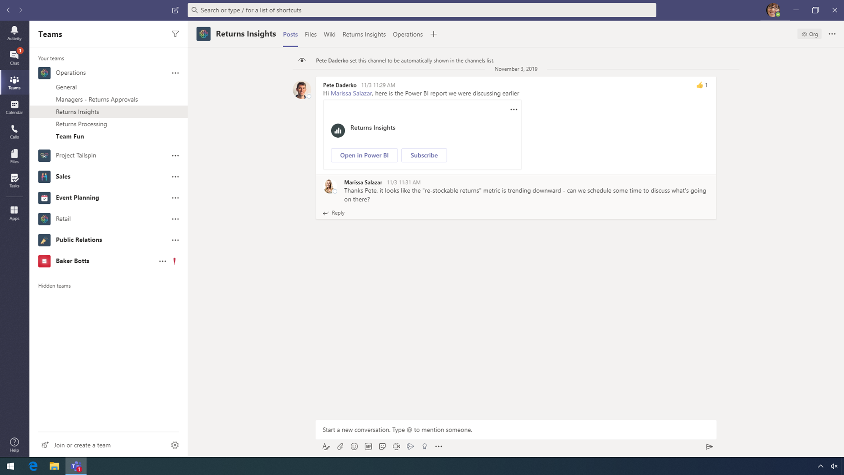
Notes:
CLICK STEP
At the top, click Returns Insights tab.

Slide 21


Notes:
With thousands of processed returns each month, managers can now leverage the newly generated data to gain valuable insights. Power BI integration in Teams offers data-driven insights are available to everyone, enabling managers to collaborate and drive informed business decisions faster.
CLICK STEP
Click the Team Fun channel of the Operations team.

Slide 22
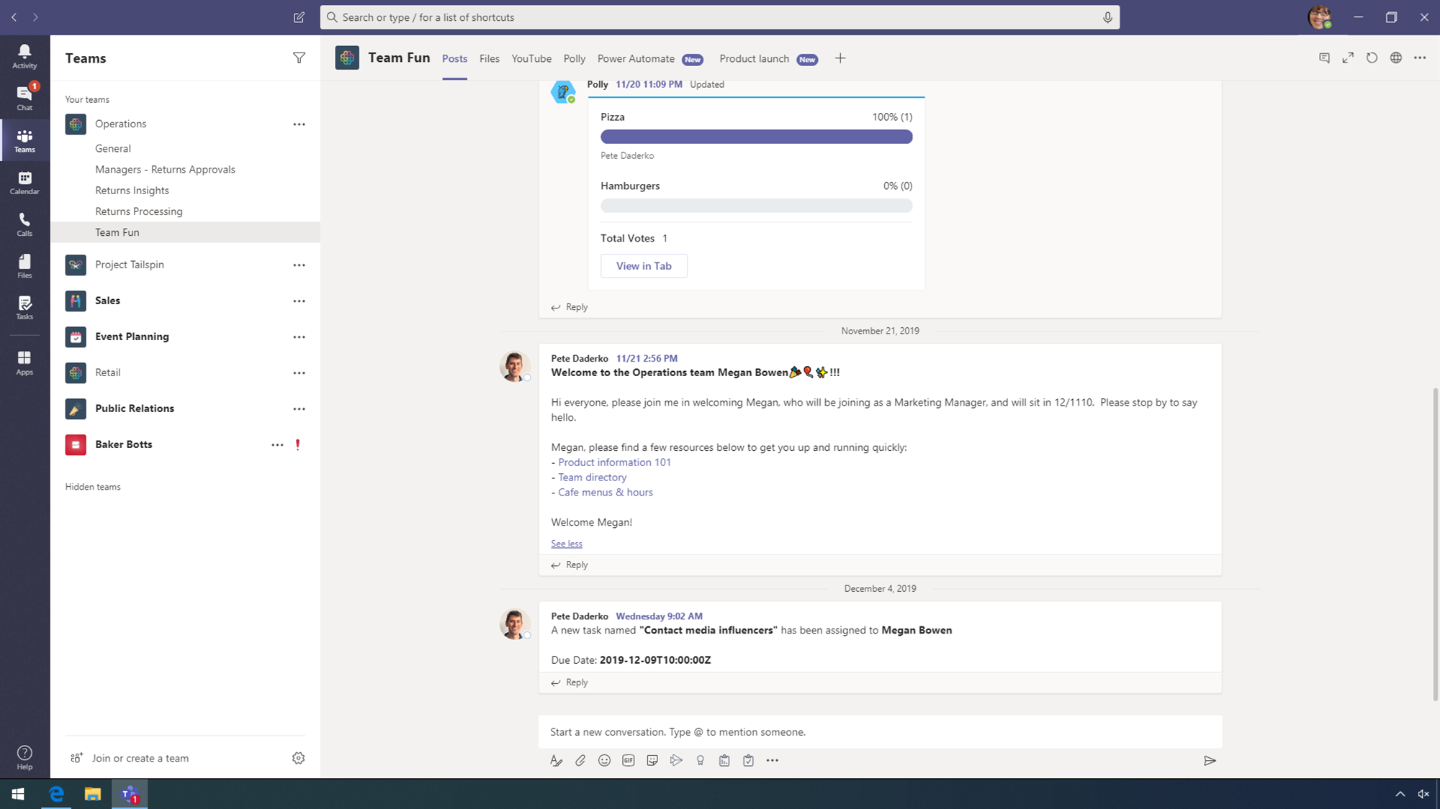
Notes:
Power Automate integrated within Teams enables team members to create flows that automate repetitive work tasks, such as adding a new member to a team.
POINT OUT:
In the team conversations, point to, but do not click, the Welcome to the Operations team Megan Bowen conversation.
Megan is automatically alerted with onboarding resources, and her team is automatically notified of a new team member – all within Teams!
CLICK STEP
At the top, click the Power Automate tab.

Slide 23
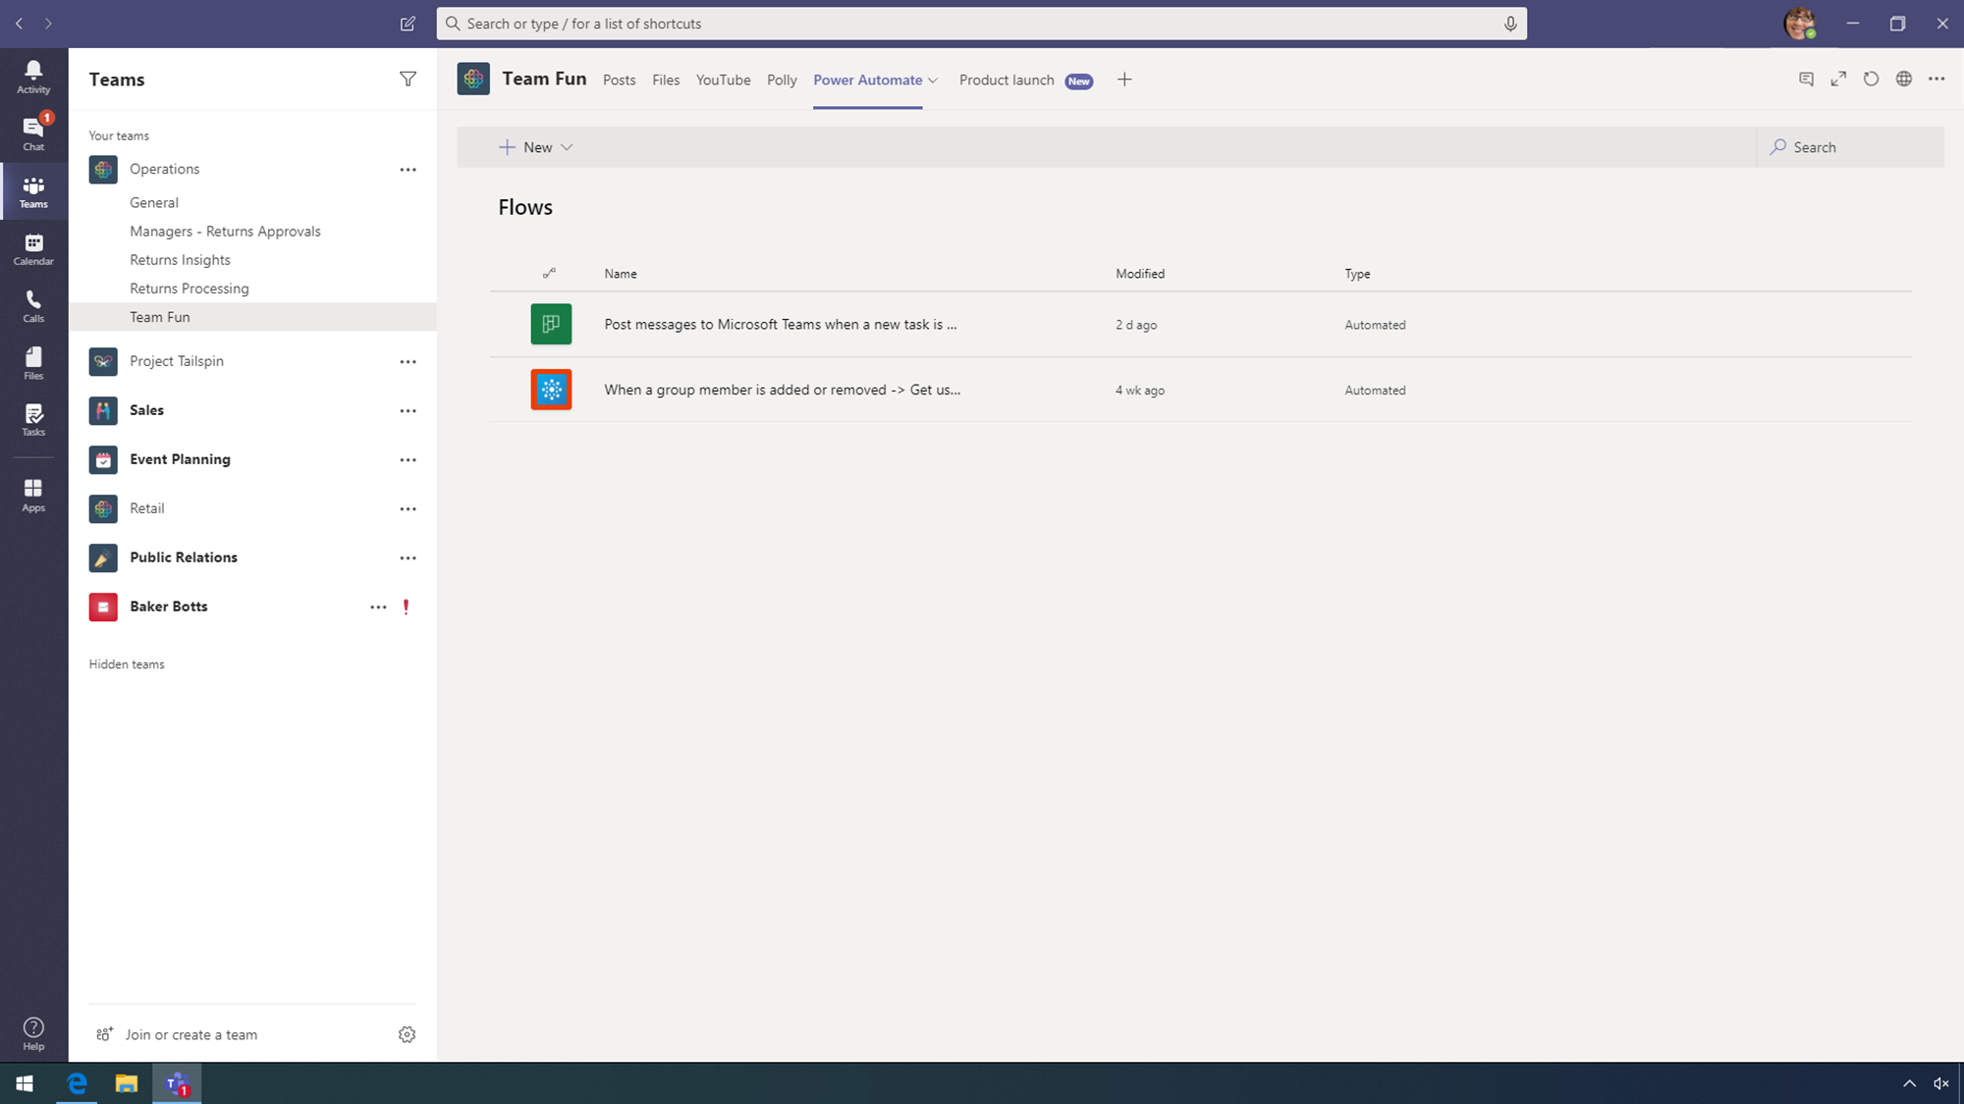
Notes:
CLICK STEP
Click the When a group member is added or removed Flow.

Slide 24
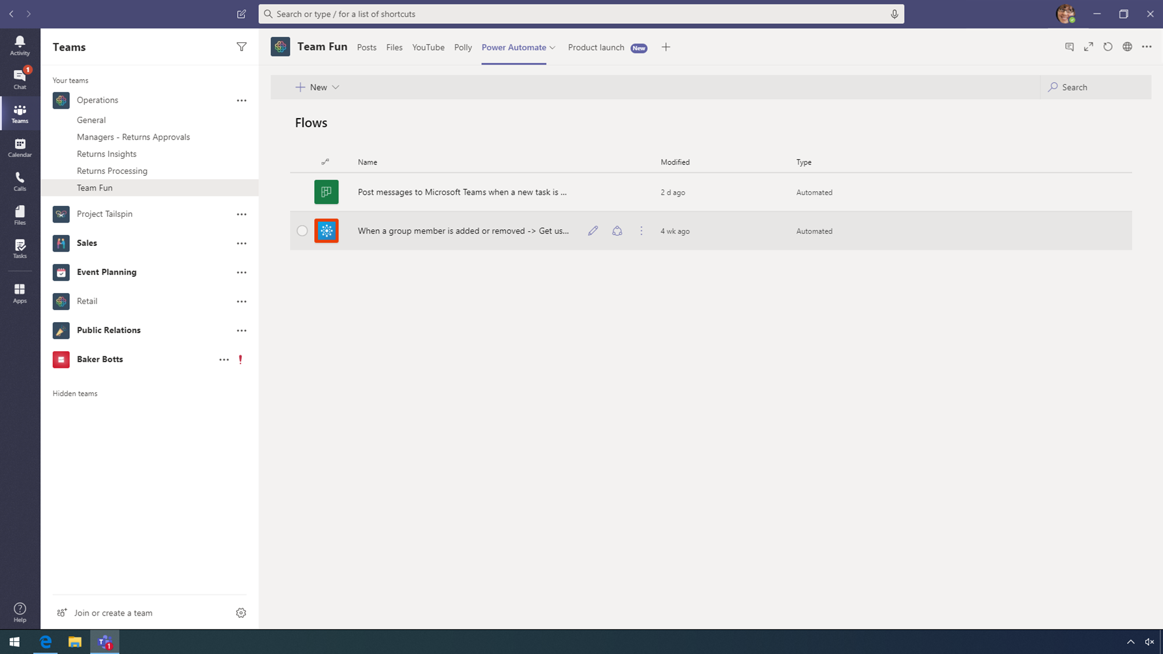
Notes:
CLICK STEP
Click edit (pencil icon).

Slide 25
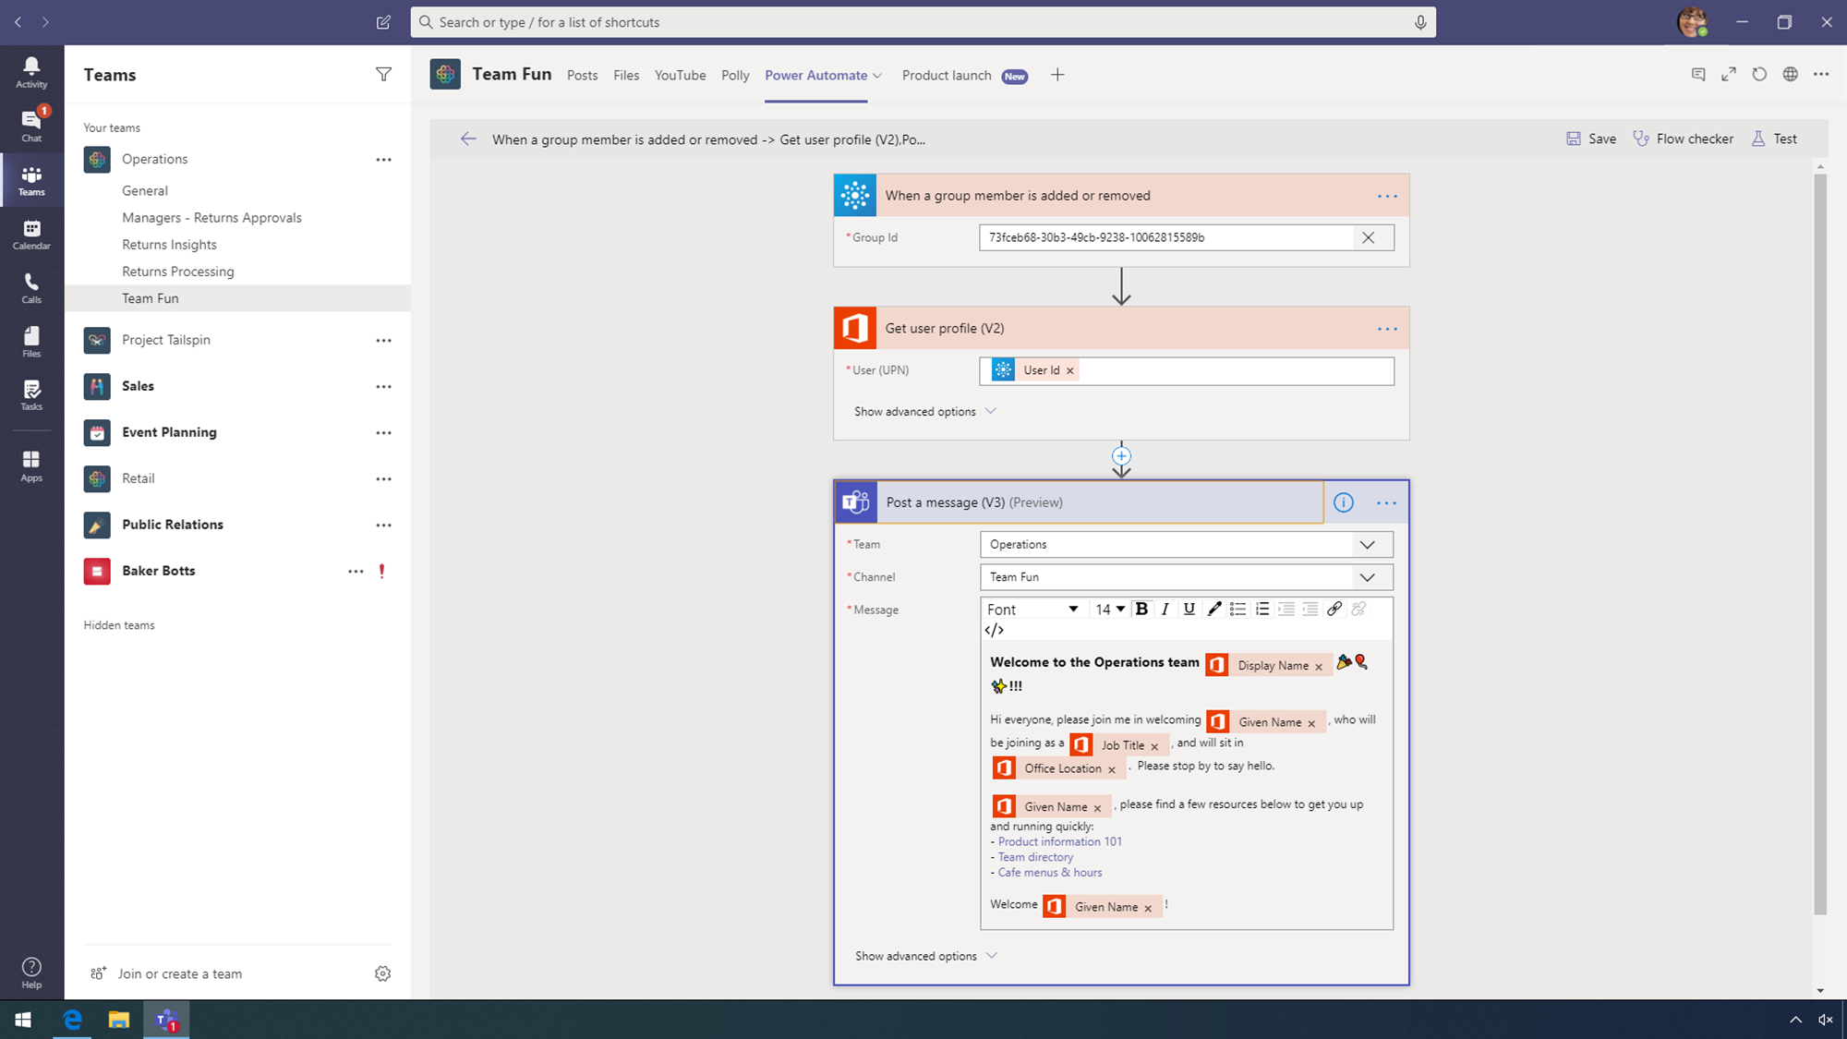
Notes:
This process is streamlined and automated once a group member is added to a specific group and a user profile is created within Office 365. A prepopulated message is then posted within the team’s conversations, alerting everyone on the team.
POINT OUT:
Point to, but do not click, the three steps of the flow: When a group member is added or removed, Get user profile, and Post a message.
Conclusion
Leveraging the Power Platform, Contoso digitized a paper-based process into an end to end solution, all while ensuring data is seamlessly integrated into Microsoft Teams for easy access.

